Slide 1
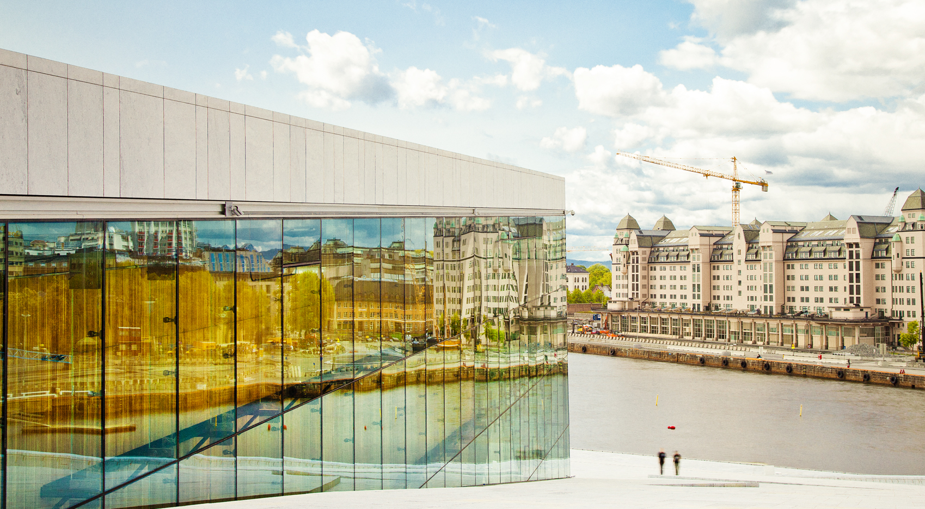

What makes a sustainable city?

Slide 2

Contents
Introduction
Inclusive City
Healthy City
Resilient city
Compact Green City
Mobility City
Low Carbon City
Circular Economy City
Smart City
Design City
Notes:
This presentation showcases the Nordic Sustainable Cities – giving everyone some insight into the shared practices that Nordic cities are using towards sustainable urban futures.
The challenges that Nordic cities face are not unique to the region, but found all over the world. The Nordic Region and its cities are on a journey towards sustainability, and we invite you to join us.

Slide 3
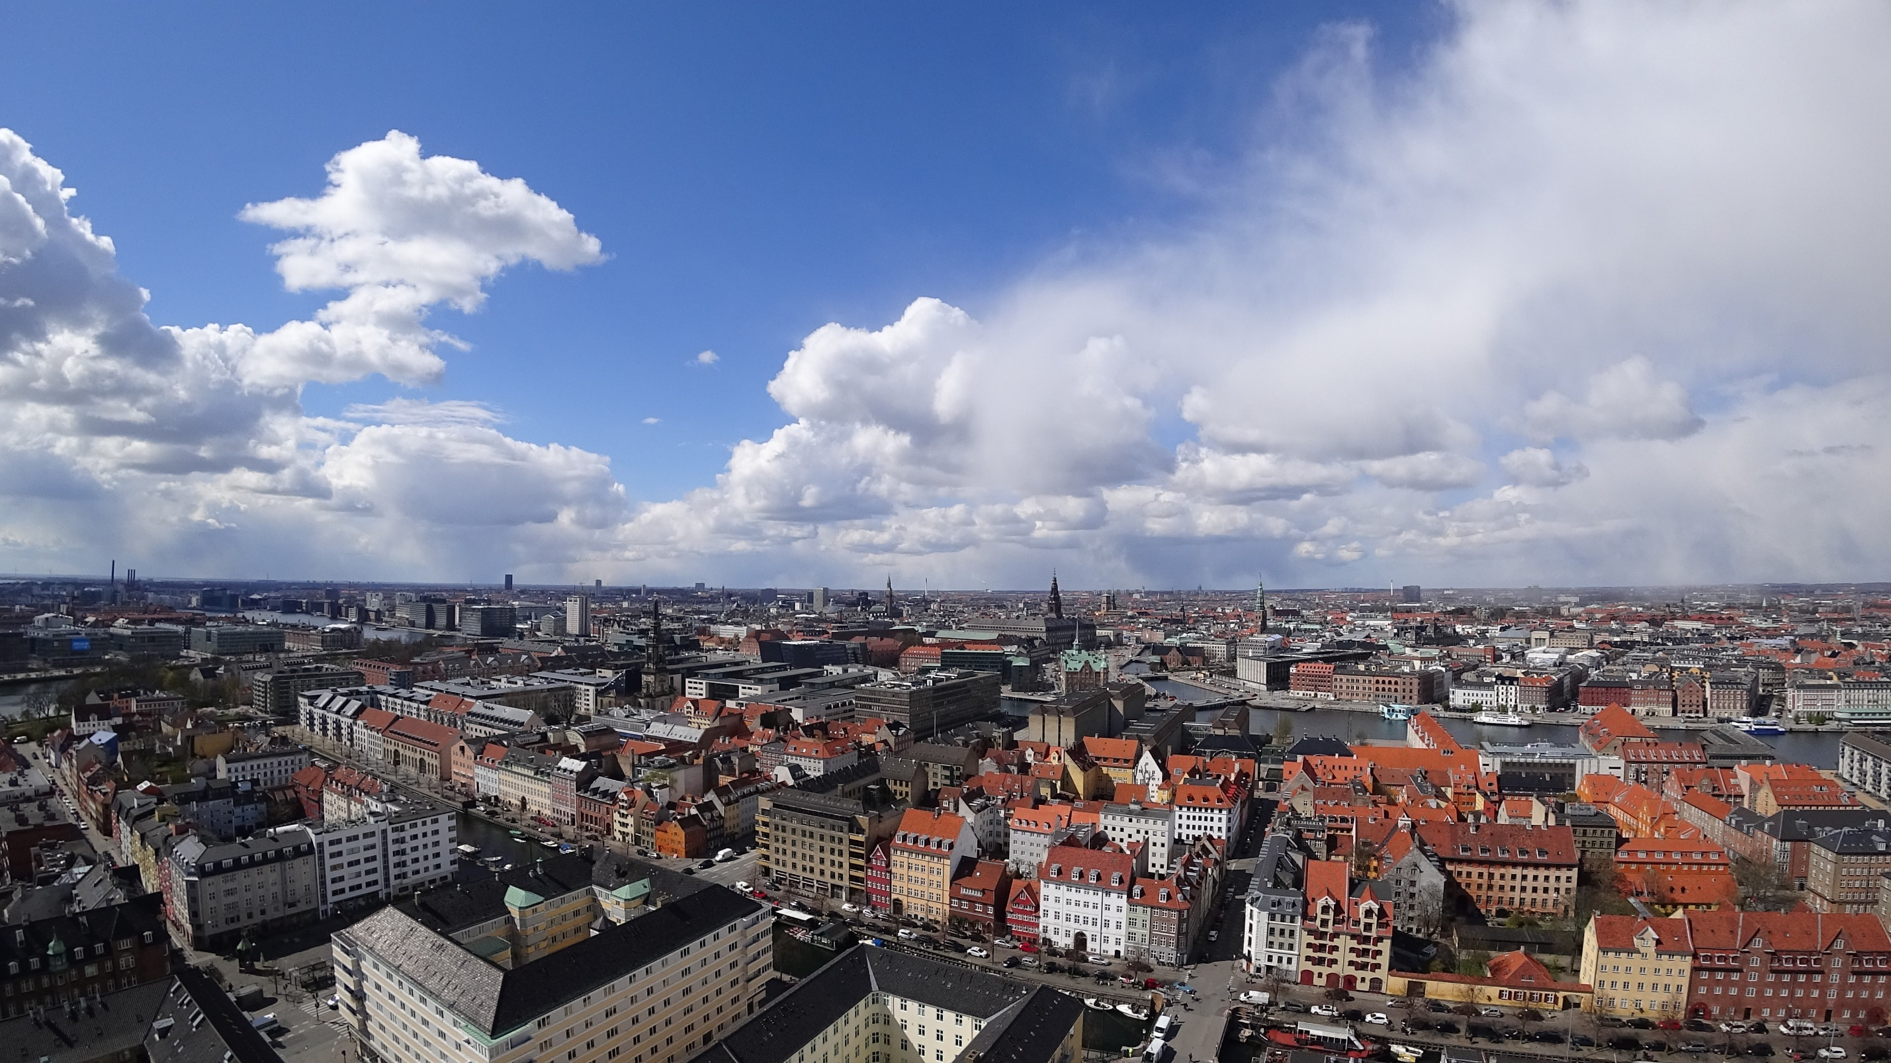
About the Nordic Region
The Nordic Region is the 11th largest economy in the world and home to 26 million people.
The region tops many international rankings in transparency, trust, environment, gender equality and happiness.
The Nordic Region has one of the most highly educated populations in the world.
The Nordic Region is innovative. We work together to find new, smart solutions.
The region has an open and free labour market. For six decades, now, people have enjoyed complete freedom of movement in the region.
Notes:
Read more about the Nordic countries in rankings here:
http://www.norden.org/en/fakta-om-norden-1/10-facts-about-the-nordic-region-and-nordic-co-operation

Slide 4
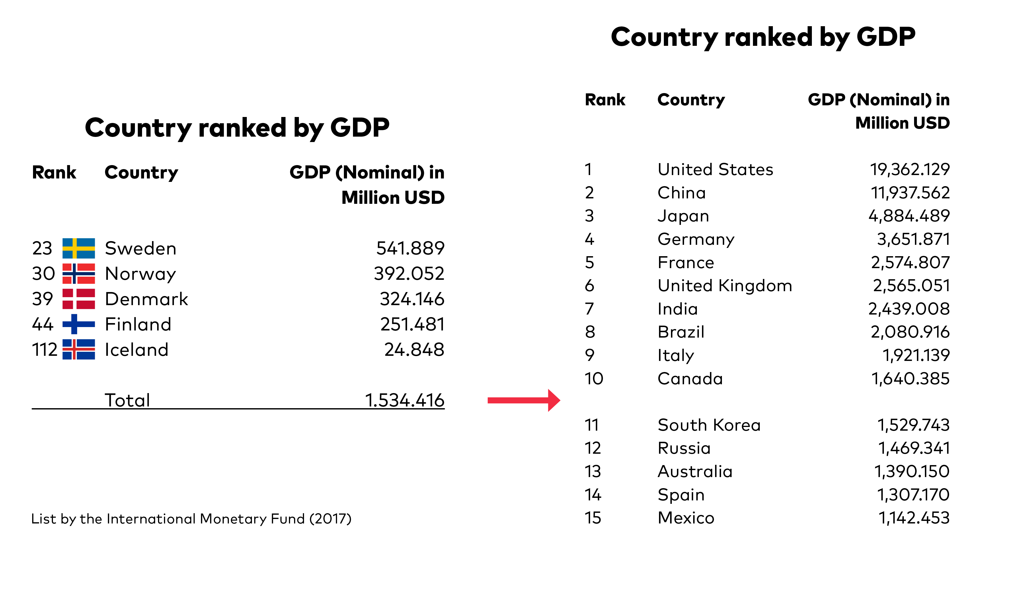
Notes:
Here you can see the individual rankings of the Nordic countries by GDP. If you combine the figures, the Nordic countries rank as the 11th largest economy.

Slide 5
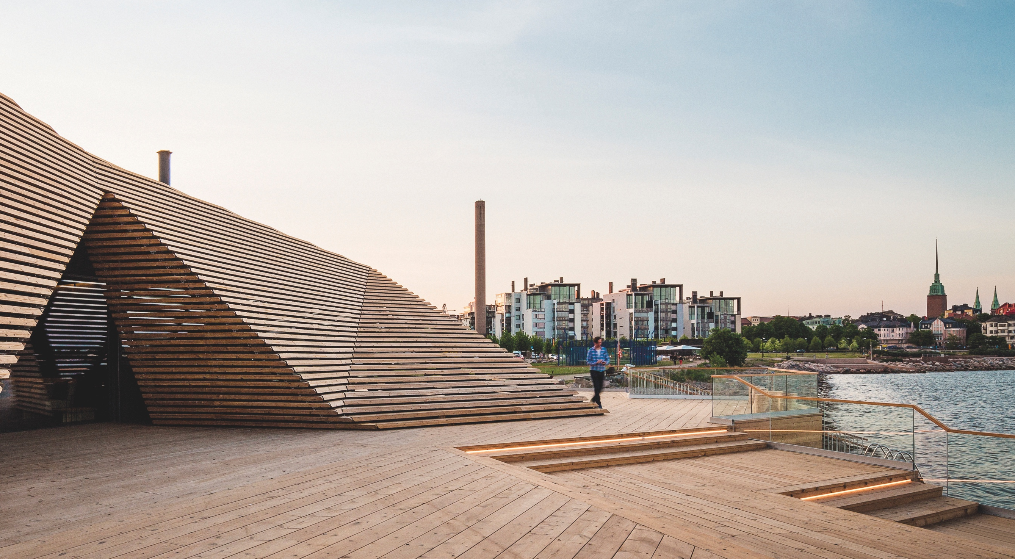
The Nordic Cities
Nordic cities are sustainable,
smart and liveable

Slide 6
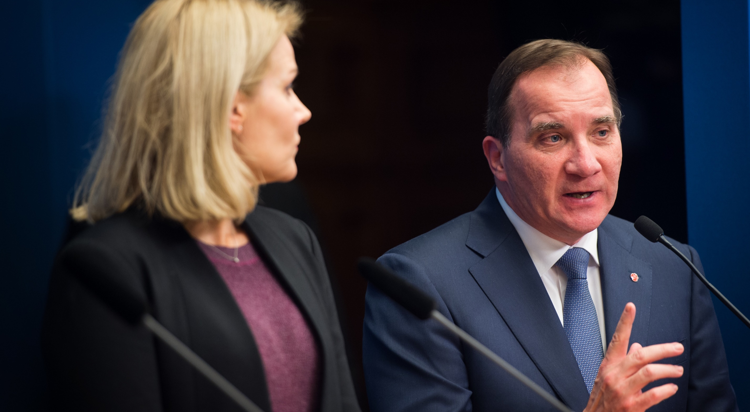
“We know that the creation of a
sustainable society will always
be a complex process. There is
no single solution but rather
thousands of small steps that
need to be taken.”
Stefan Lövfen
Prime Minister of Sweden

Slide 7
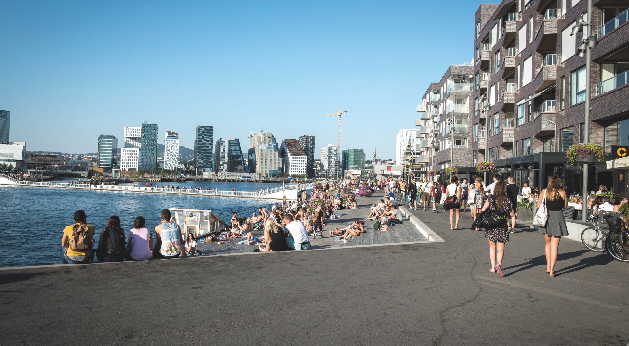

Cities made for and by the people
Notes:
With a focus on the human scale and the enhancement of people’s everyday lives, the Nordic cities are some of the world’s most accessible, pleasant and safest places in the world to live.
From Jan Gehl’s “cities for people” mantra to the Nordic charter for universal design – strategies that ensure people have access to public space continue to shape the Nordic cities today.

Slide 8

Inclusive City
Gothenburg, in Sweden, is experimenting with new methods of rent control on newly built apartments in the large Frihamnen brownfield development project.
Copenhagen has initiated campaigns to increase public support for wind energy. The campaign efforts have reduced resistance against wind turbines in the city, and paved the way for building more than 100 new and off-shore wind turbines by 2025.

Slide 9
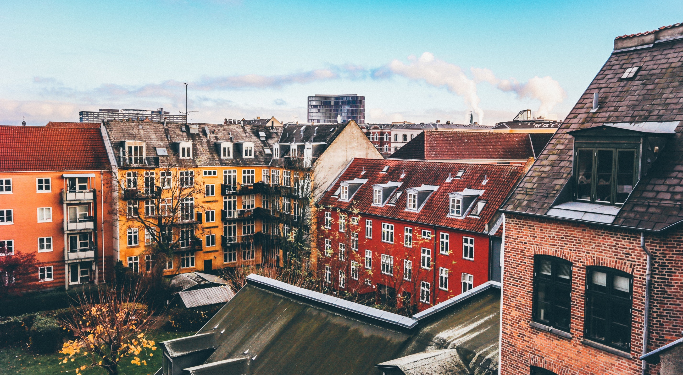
Inclusive City
The Nordic countries have developed a Nordic charter for universal design.
Nordic cities are ambitious regarding accessibility and safety in public spaces.
Participatory planning is highly valued and expected to contribute to more democratic societies .
Finland is the only European country with falling homeless rates.

Slide 10
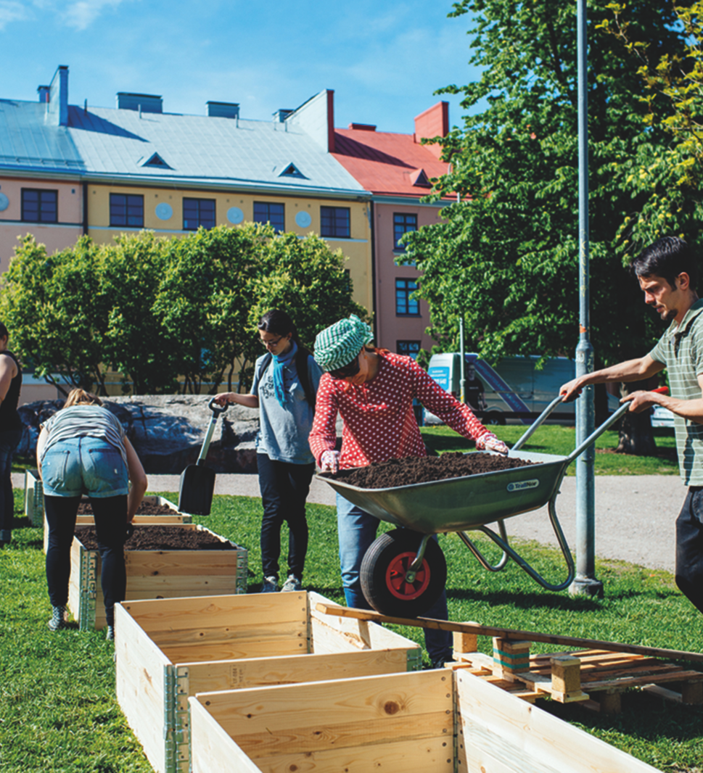
Case story:
Helsinki, Finland
The City of Helsinki uses a mixed tenure housing policy to counter social segregation, bringing people of all backgrounds together in neighbourhoods.
Notes:
Read more about the Finnish housing policy here:
https://www.hel.fi/hel2/tietokeskus/julkaisut/pdf/07_04_03_Tutkkats_2_Niska.pdf

Slide 11
“We continuously strive for readable accessibility and seek to represent an attitude in architecture which includes
social behaviour. This may be achieved by a certain degree of intimacy between public and projects, a touchable reality
leading to public ownership.”
Kjetil Thorsen
founding partner, Snøhetta
Notes:
Kjetil Thorsen is a founding partner in the prominent architectural firm Snøhetta. Snøhetta has its origin in Norway, but continues to reach out globally with its Nordic-inspired design – from New York to London and San Francisco to Alexandria.

Slide 12
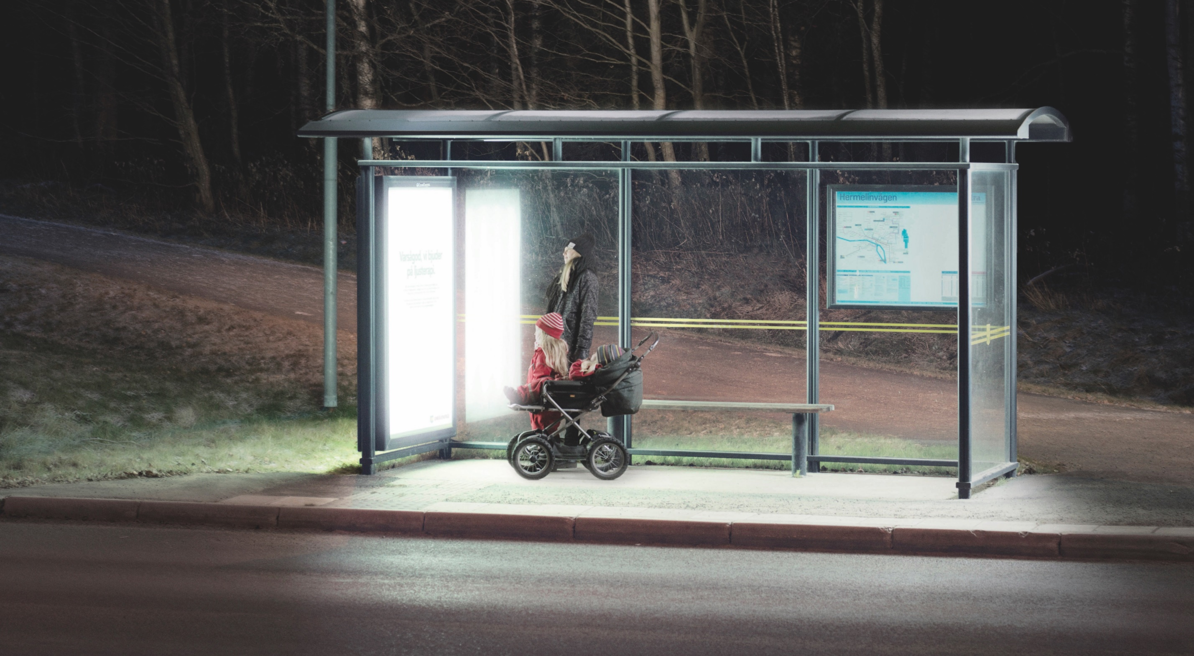

Human well-being and environmental health are one and the same
Notes:
In the Nordic countries, human well-being and environmental health are one and the same. The Nordic cities are applying practices that bring city, nature and health under one strategic umbrella.
Across the Nordic Region, cities are using the natural landscape as the underlying principle for urban development. This helps improve human physical and mental well-being.

Slide 13
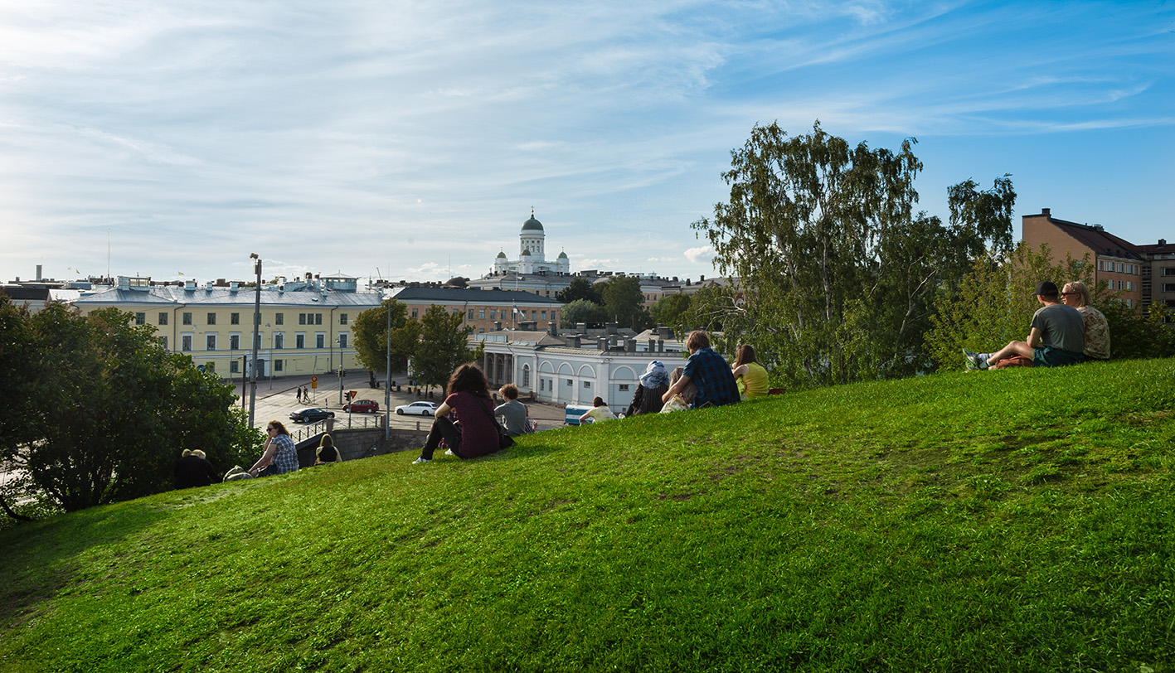
Healthy City
Green areas reduce air pollution, mitigating the heating effects of grey structures and increase accessibility to green spaces.
By preserving nature and access to clean waterscapes, the Nordic cities are offsetting negative climatic effects, while increasing biodiversity and recreation.

Slide 14
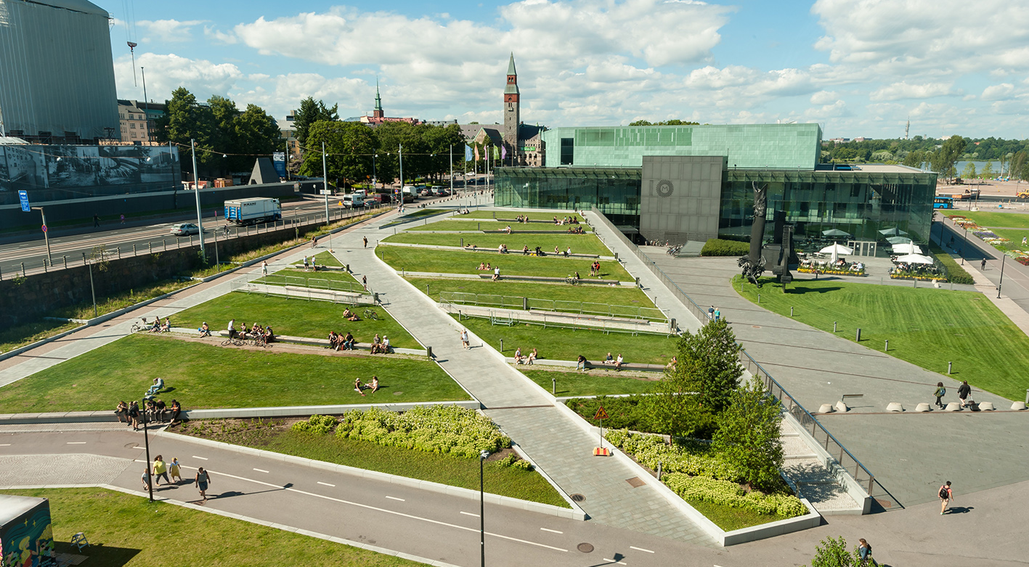
Healthy City
In Stockholm, 47% of the total area is undeveloped land.
In Helsinki, greenery covers 40% of the city’s land surface, forming a network of ‘recreation areas’.
Reykjavik also has a “green scarf”, a forest and outdoor recreational area at the edge of the urban growth area.

Slide 15
Case story:
Umeå, Sweden
Umeå invites commuters to soak up the benefits of light therapy at bus stops. Installed with anti-SAD (Seasonal Affective Disorder) lamps, the repurposed bus stops have lead to an increase in public transport usage while bringing the benefits of nature’s best qualities to residents in the dark winter months.
Notes:
Read more about Umeå and its anti-SAD project here:
https://reprogrammingthecity.com/light-therapy/
https://visitsweden.com/umea/

Slide 16
Case story:
Copenhagen, Denmark
The Copenhagen Harbour Baths are a result
of an extensive clean-up initiative that
has rid the harbour of industrial pollutants
and sewage. Bathers can enjoy access
to Copenhagen’s three harbour baths
and two urban beaches all year round.
Notes:
Read more about the Copenhagen Harbour Baths here:
http://www.visitcopenhagen.com/copenhagen/islands-brygge-harbour-bath-gdk482346
https://www.archdaily.com/11216/copenhagen-harbour-bath-plot

Slide 17
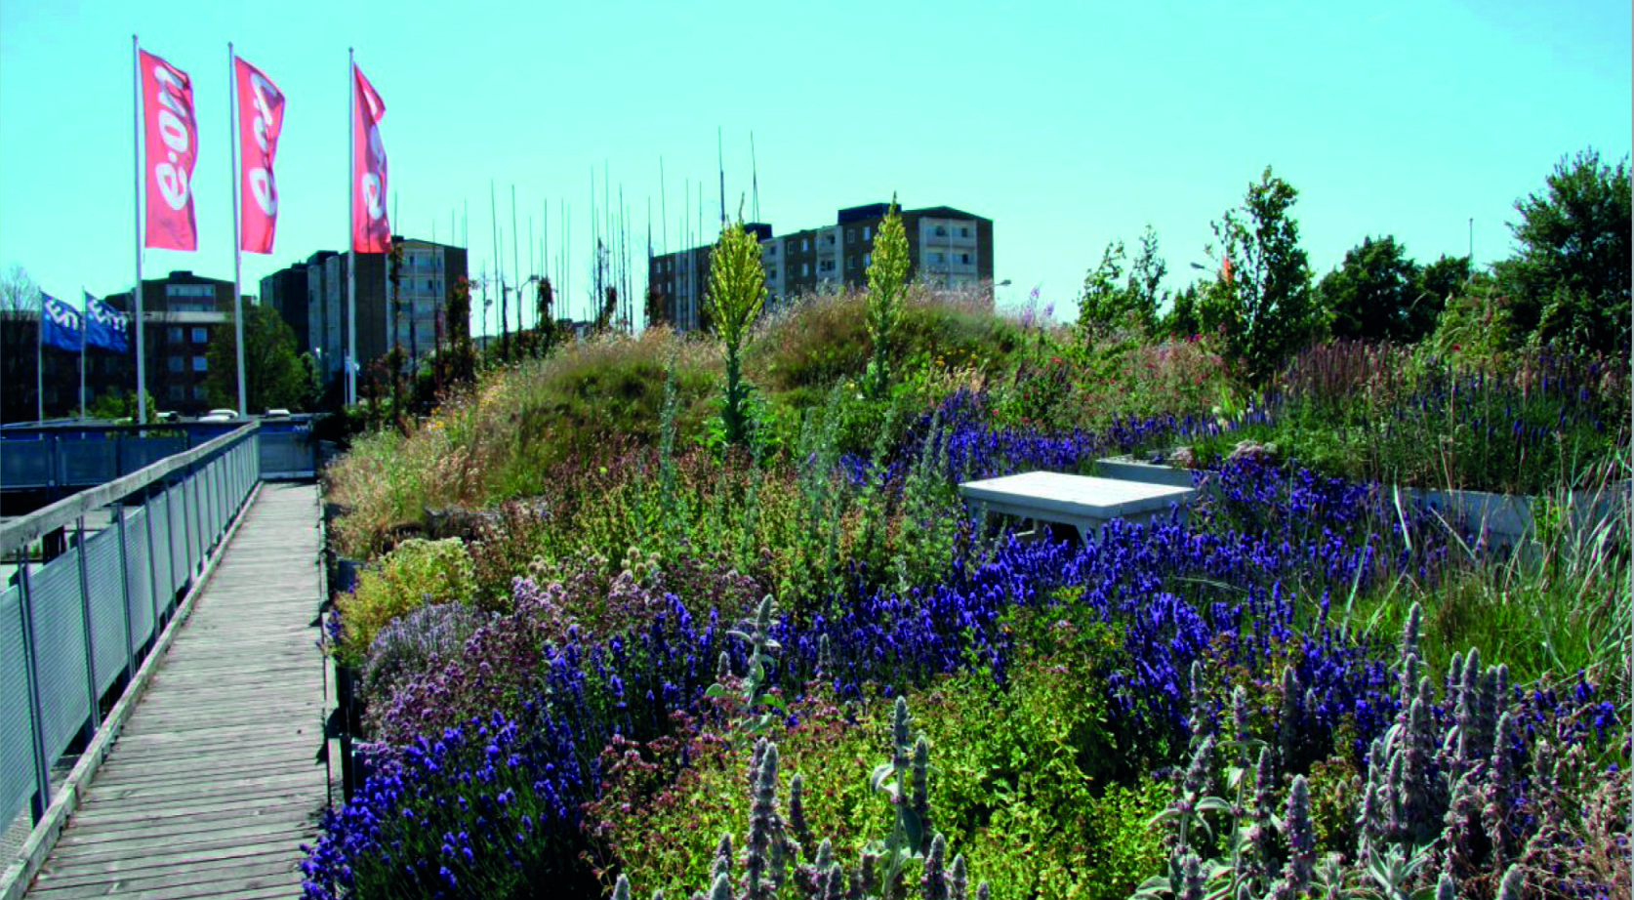
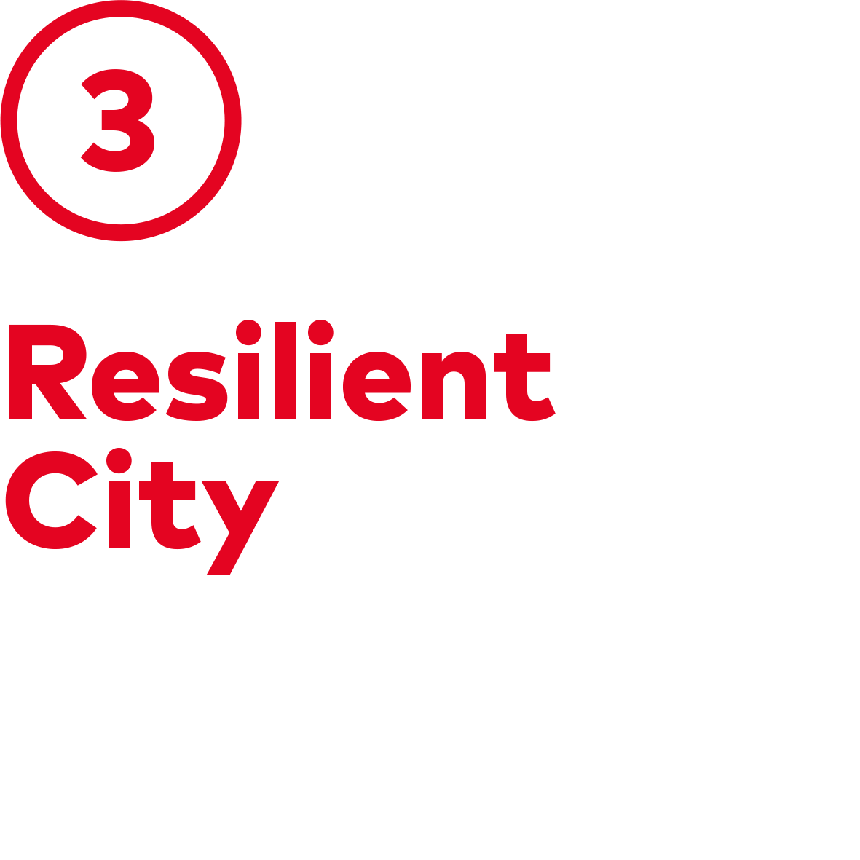
Climate change adaption across actions
Notes:
The Nordic region has a unique balance of adaptation practices to safeguard against climate change. The Nordic cities are developing resilience through multifunctional urban spaces, innovative planning tools, and circular ecosystem initiatives.
The Nordic Region promotes sustainable urban development with the decoupling of emissions from economic growth.

Slide 18
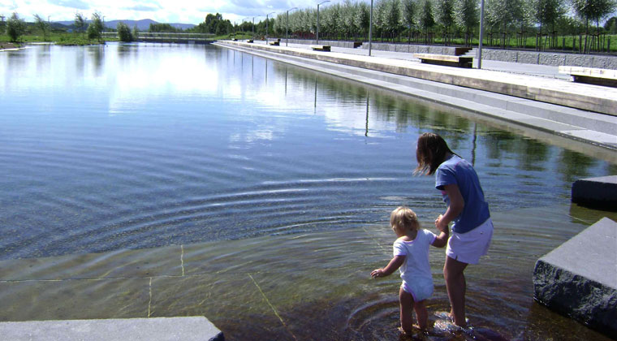
Resilient City
Photo: Bjørbekk & Lindheim landskapsarkitekter
The Danish Nature Agency has developed PLASK (splash) - a free-to-use tool that helps calculate the socio-economic consequences of climate adaptation in local areas.
Nansen Park in Norway includes solutions for the managing of stormwater, green structures with gutters, filtration ponds, retention basins and an outlet to the sea.
Notes:
Additional information on PLASK: The tool has already demonstrated its economic benefits. For instance Lolland Municipality has used it to learn how it can save DKK 20 million.
Additional information on Nansen Park: The park is a former airport. The former Fornebu International Airport in Norway closed in 1998 and has now been transformed into residential and recreational areas.

Slide 19
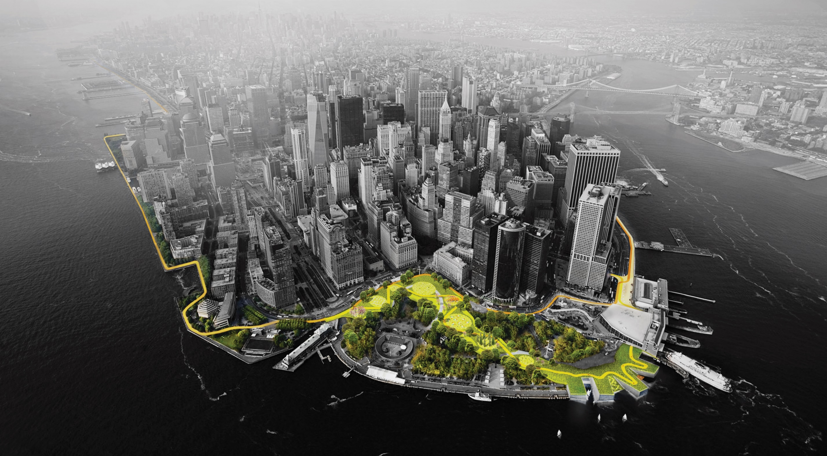
Resilient City
Photo: BIG-Bjarke Ingels Group
The Big U, by Danish architects BIG, is a protective system around Manhattan, designed to shield the city from floods and stormwater.
Bergen is the most rainy city in Europe – it receives around 3 metres of rain every year and therefore has a lot of know-how about how to prevent flooding.
Notes:
Additional information on The Big U: The project also provides social and environmental benefits to the community, and an improved public realm.
https://www.bergen.kommune.no/bk/multimedia/archive/00136/MARE_UrbanPlanningC_136185a.pdf
http://www.rebuildbydesign.org/our-work/all-proposals/big-u

Slide 20
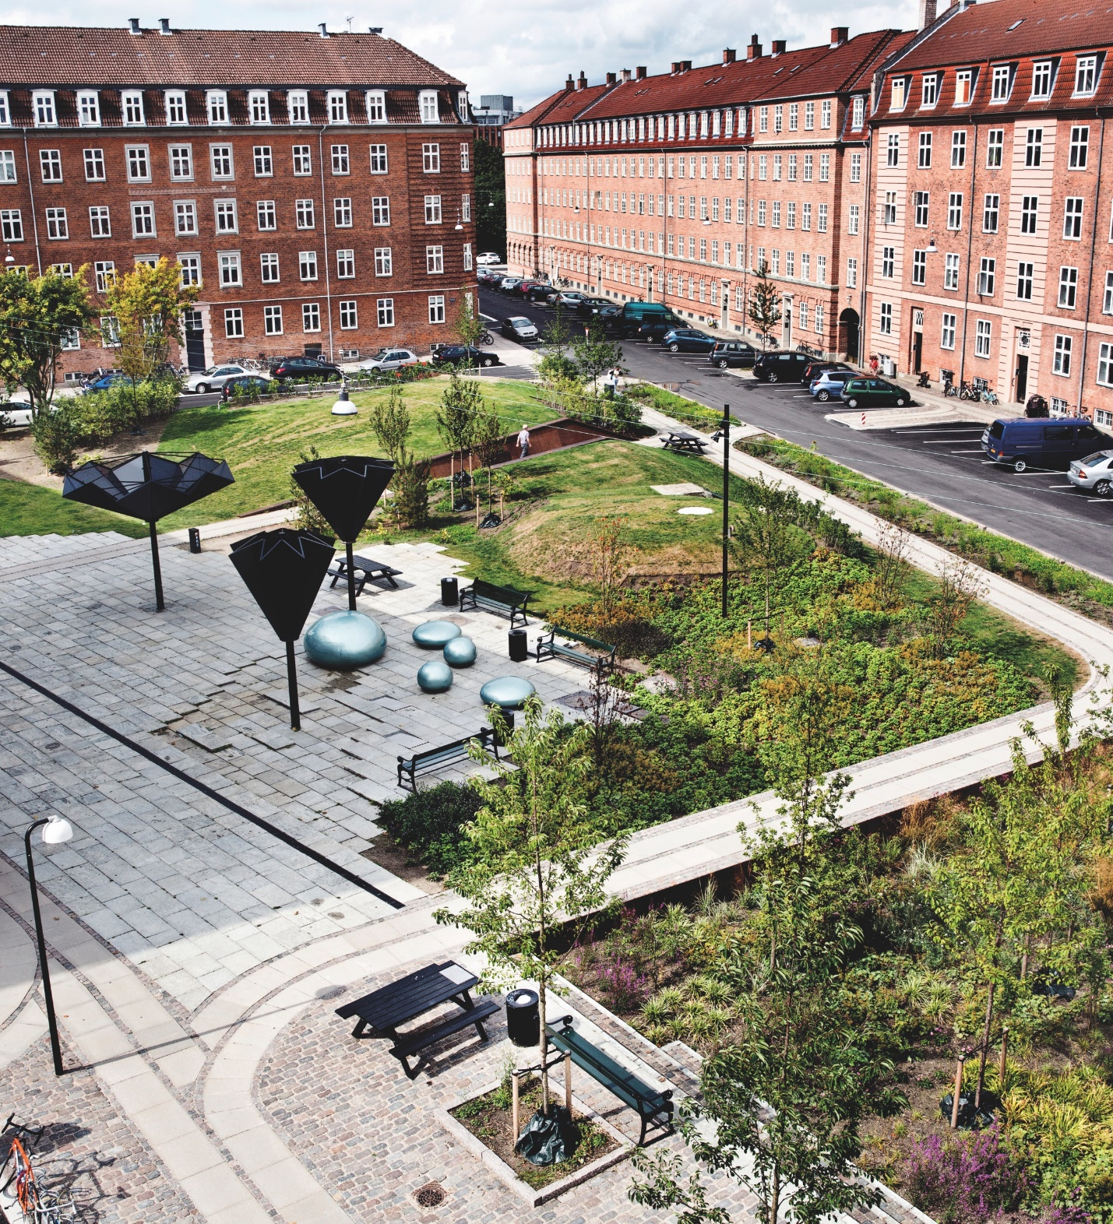
Case story:
Tåsinge Plads, Denmark
Tåsinge Plads is Copenhagen’s first
climate-resilient urban space. It can
handle rising volumes of rain at street
level. 1,000 square metres of unused asphalt have been transformed into an urban landscape, and Tåsinge Plads can delay and percolate rainwater from a surrounding area of 4,300 square metres.
Notes:
Read more about Tåsinge Plads here:
http://klimakvarter.dk/en/projekt/tasinge-plads/

Slide 21
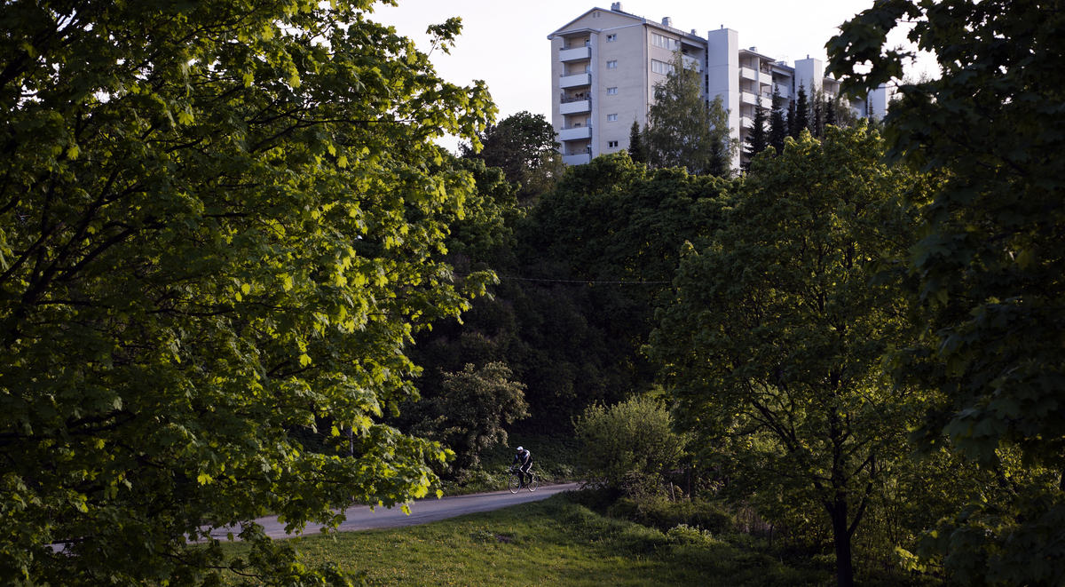

Balancing density and green infrastructure
Notes:
Striking a balance between urban density and access to nature is a challenge faced by cities around the world.
The Nordic Compact Green City is a model that promotes urban development without compromising the benefits of nature, water and green areas for urban dwellers.

Slide 22
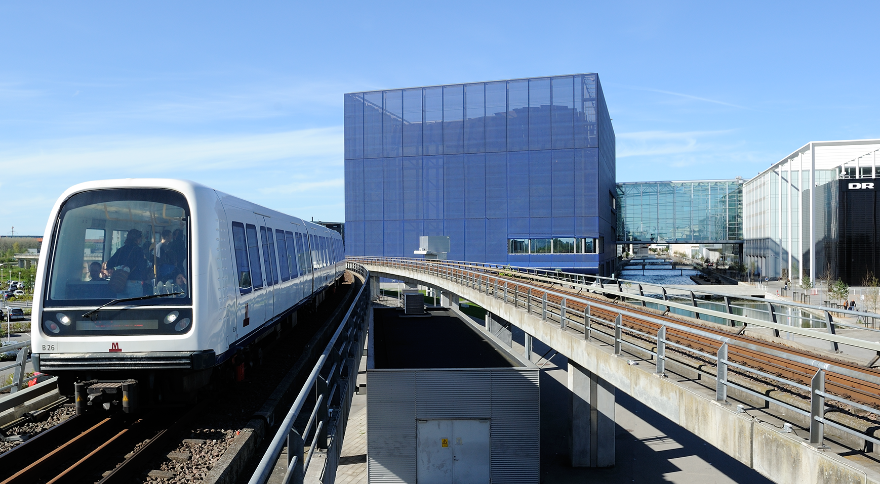
Compact Green City
Photo: Tim Adams
Nordic cities are working to prevent urban sprawl by reconfiguring existing structures.
Copenhagen’s urban development plan, known as the ‘Finger Plan’, champions the ‘near-to-station-principle’. Whenever possible, new workplaces should be located close to public transport.
Studies show that outside central municipalities, only 40-60% of residents travel by car instead of public transport if they live within 600 metres of a well-functioning public transport station. If they have to travel more than 600 metres to get to a station, 75-85% travel by car.
1-2. Borges, Luciane Aguiar et al. (2017): ”White Paper on Nordic Sustainable Cities”. Stockholm: Nordregio, pp. 38-39
3. Nielsen, Peter-Hartoft (2007): ”Fingerplan 2007”. København: Skov- og Naturstyrelsen, pp. 23
Notes:
Additional information on urban sprawl: Good examples are Western Harbour in Malmö, Hammarby Sjöstad in Stockholm, and Pilestrædet Park in Oslo.

Slide 23
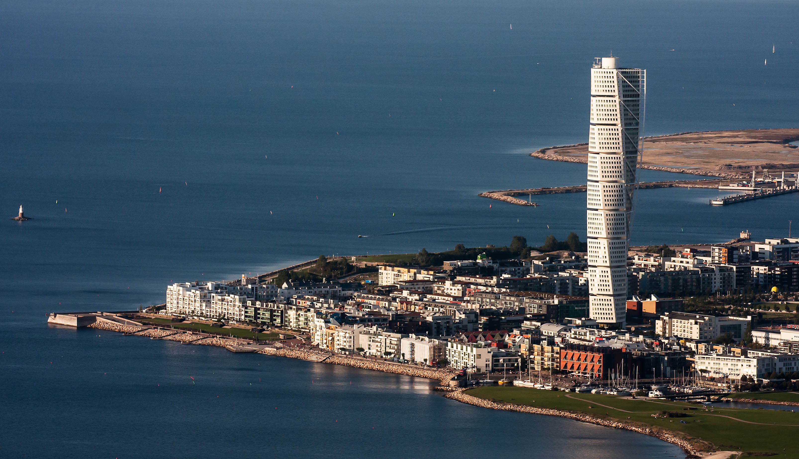
Compact Green City
In a pioneering project in Sweden, the planning authorities in Malmö required a green space factor of 0.5 for the expansion of the city’s Western Harbour.
In Reykjavik, Iceland, 90% of all new residential units will be built inside the current urban area borders. This is to increase the close-proximity of public services and to reduce travel needs.

Slide 24
Case story:
Oslo, Norway
The former hospital area of Pilestredet
Park, Norway, was converted into housing,
commercial and recreational space in
2006. The focus was on reusing existing
materials and access to pocket parks
and water features in the area.
Notes:
Read more about Pilestredet Park here:
http://www.skanska-sustainability-case-studies.com/index.php/latest-case-studies/item/18-pilestredet-park-norway?tmpl=component&print=1

Slide 25
“We’ve managed to bring nature into the city. In Stockholm, closeness to water and nature, in Finland closeness to forest. These natural elements are well-integrated into urban development so it is quite a contrast to the urbanity you find outside the Nordic Region.”
Tina Saaby
City Architect, Copenhagen
Notes:
Tina Saaby is the City Architect of Copenhagen. She graduated from the Royal Danish Academy of Fine Arts, Schools of Architecture, Design and Conservation in 1997.

Slide 26
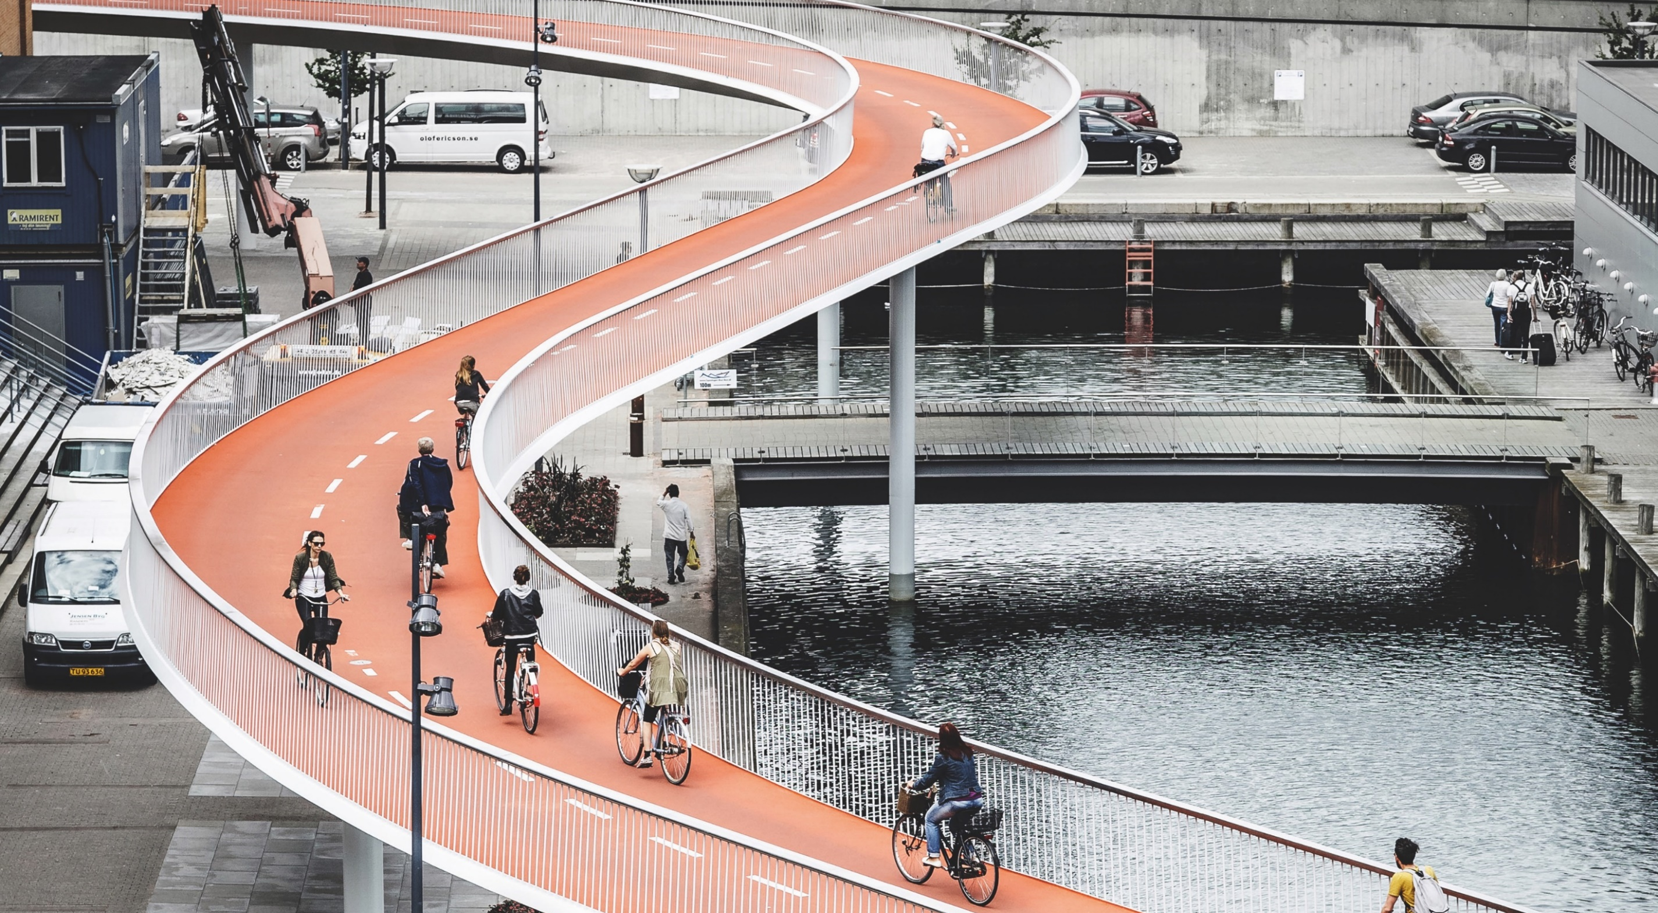
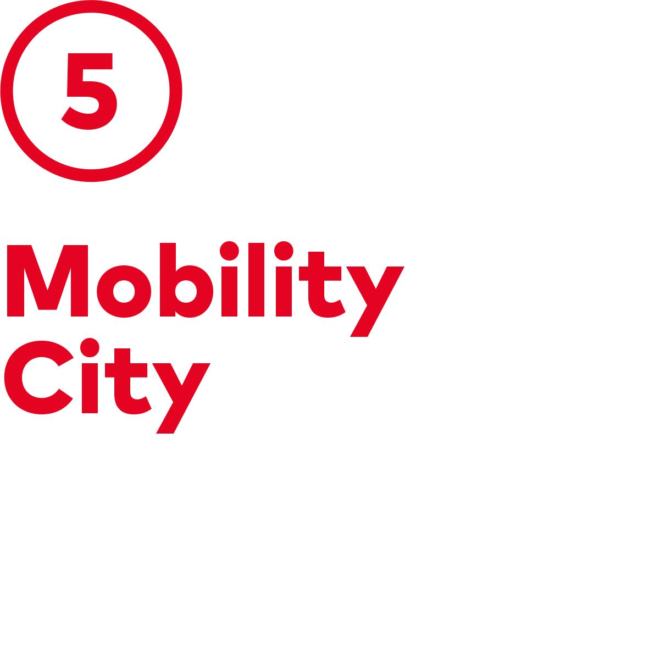
Safe and clean transport for all
Notes:
The Nordic Mobility City is characterised by its many public and private transport options. They are well-connected, convenient, time- and energy-efficient, affordable, safe and, of course, environmentally friendly.
This enables the Nordic cities to provide safe and clean transport for all.

Slide 27
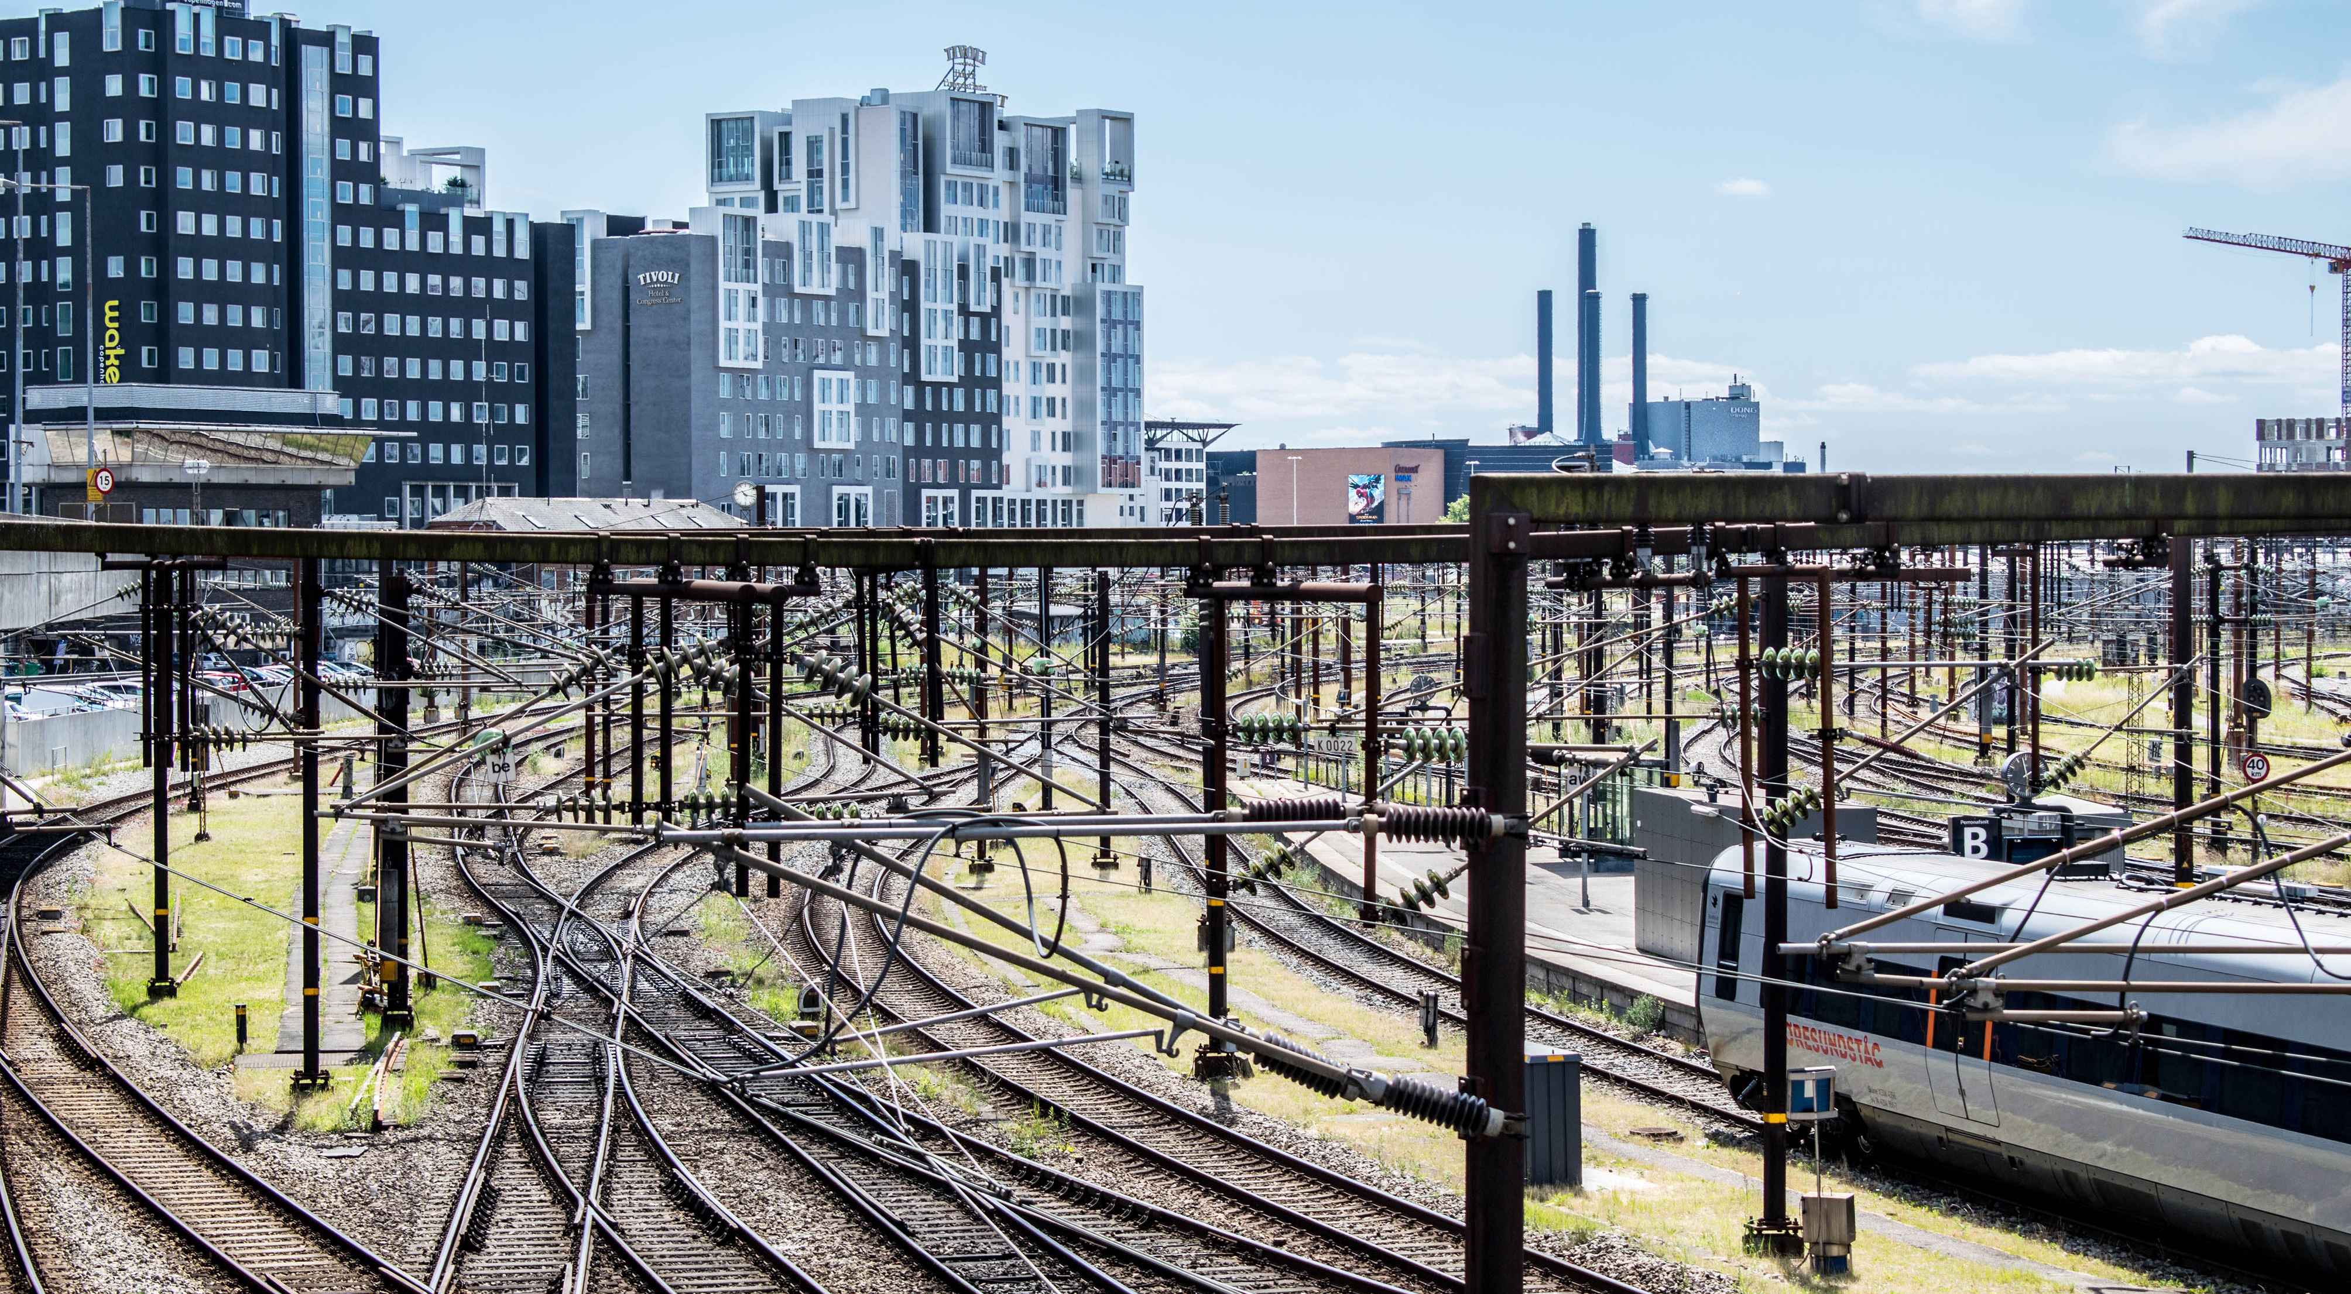
Mobility City
Several Nordic cities offer a range of car-sharing opportunities. Sunfleet, developed by Volvo, is a good example.
Sustainable urban mobility is promoted by offering cultural and retail services around transport hubs.
Maas, mobility as a service, integrates various types of transport services into a single mobility service that is accessible on demand.
Notes:
Additional information on transport hubs: Good examples are the redevelopment of the central stations in Odense, Denmark and Uppsala, Sweden.
Additional information on Maas: Good examples are Helsinki Regional Transport and Rejsekort in Denmark.

Slide 28
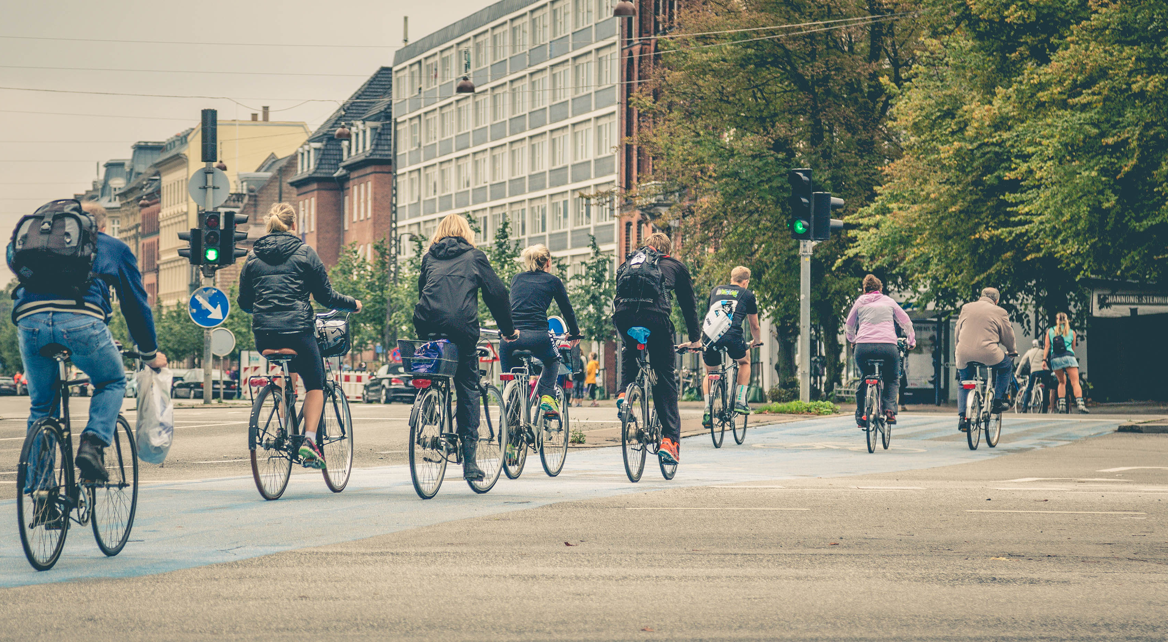
Mobility City
Photo: Tony Webster
Oslo is the world leader in switching to emission-free transport, thanks to ambitious investments in electric cars.
The Helsinki Metropolitan Area gas bus fleet will run on renewable biogas in 2017.
In Copenhagen, cyclists save the city more than 90,000 tonnes of carbon emissions, annually.
Notes:
Additional information on the Helsinki busses: The bus company Helsingin Bussiliikenne Oy (HelB) will use 100% Finnish biogas made from biodegradable waste, to replace natural gas as a bus fuel. Emissions will be cut by 1,367 tonnes a year. This corresponds to the emissions generated by driving a gasoline-fuelled car for appro. 11 million kilometres.

Slide 29
Case story:
Oslo, Norway
The Oslo city centre will be car-free
by 2019. Under development, the city
is removing all on-street parking and
narrowing car lanes to build new bicycle
paths and prioritise pedestrians.
Notes:
Read more about Oslo’s plans to create a car-free city centre here:
https://www.oslo.kommune.no/english/politics-and-administration/green-oslo/best-practices/car-free-city/#gref

Slide 30
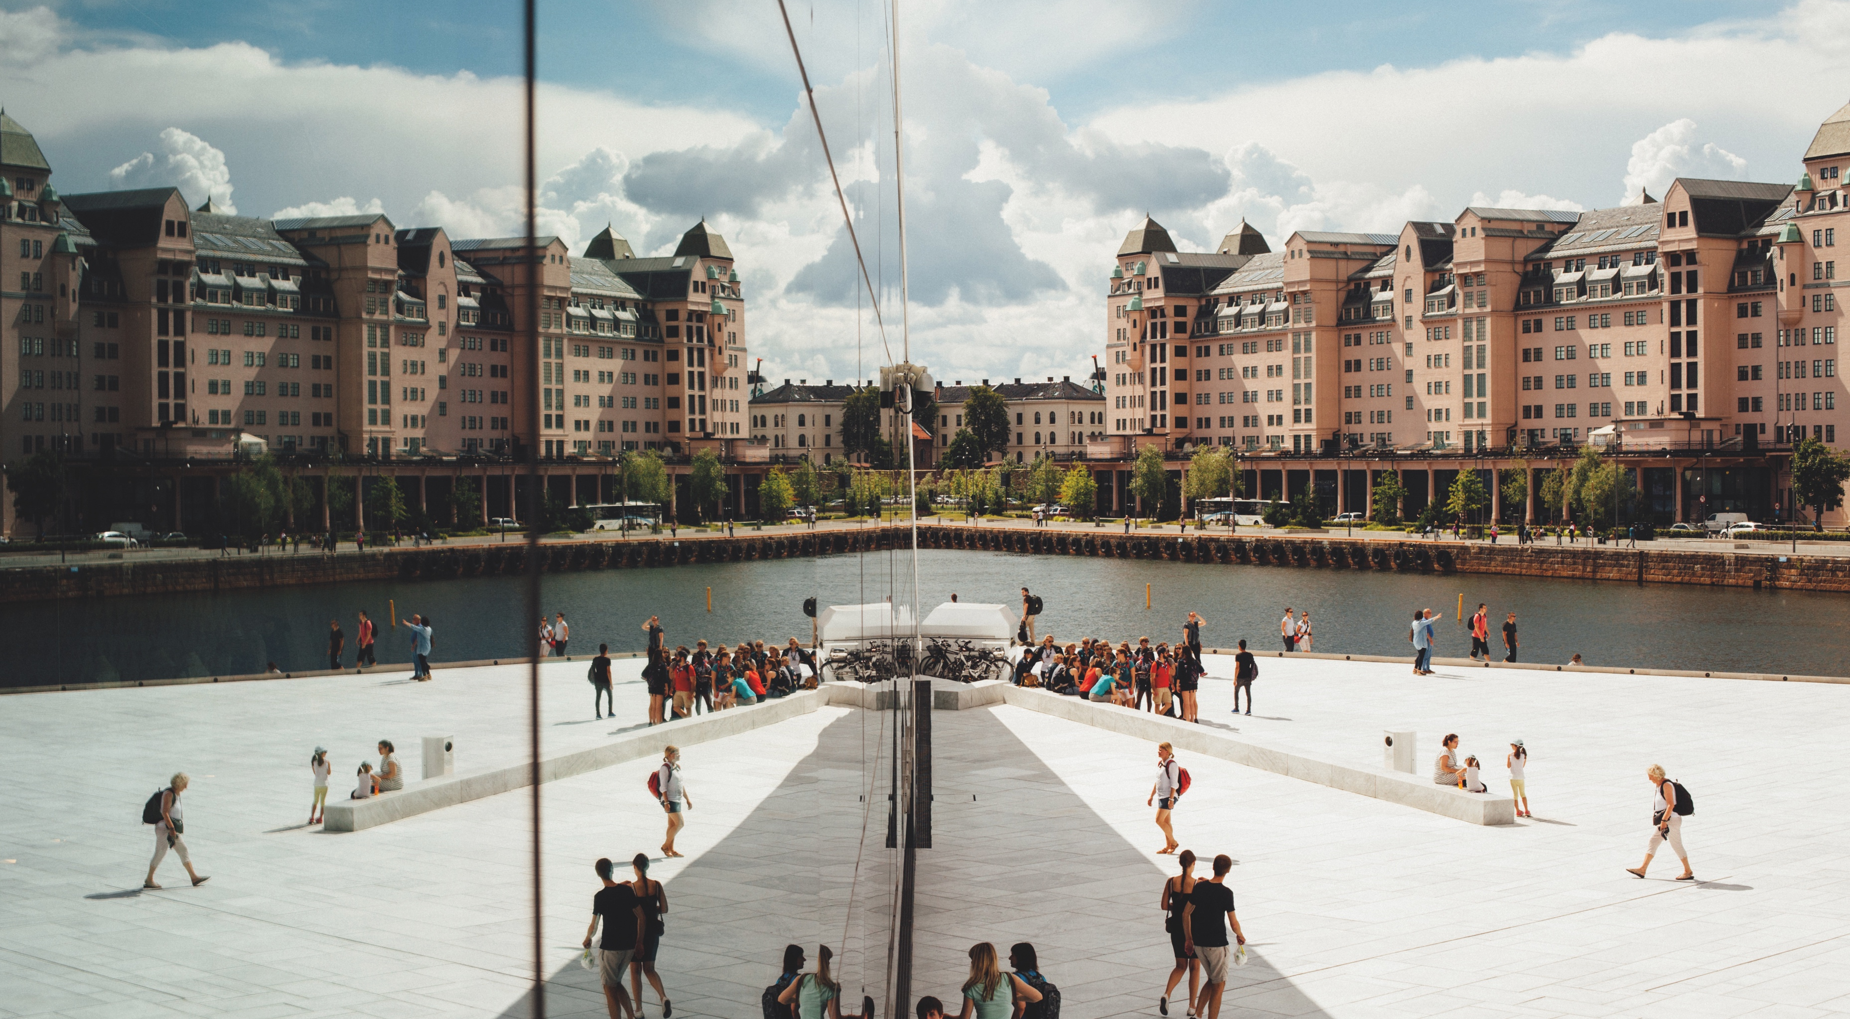

Growing without increasing emissions
Notes:
Urban areas are home to approximately 85% of the Nordic population. The Nordic Low Carbon City capitalises on the close proximity of urban residents, converging initiatives that reduce emissions without impacting economic growth.
Many buildings are built to exceed the national building standards and multimodal transport networks promote collective journeys. Renewable energy is integrated into the energy supply for both industry and residential areas – and recently also for public transport.

Slide 31
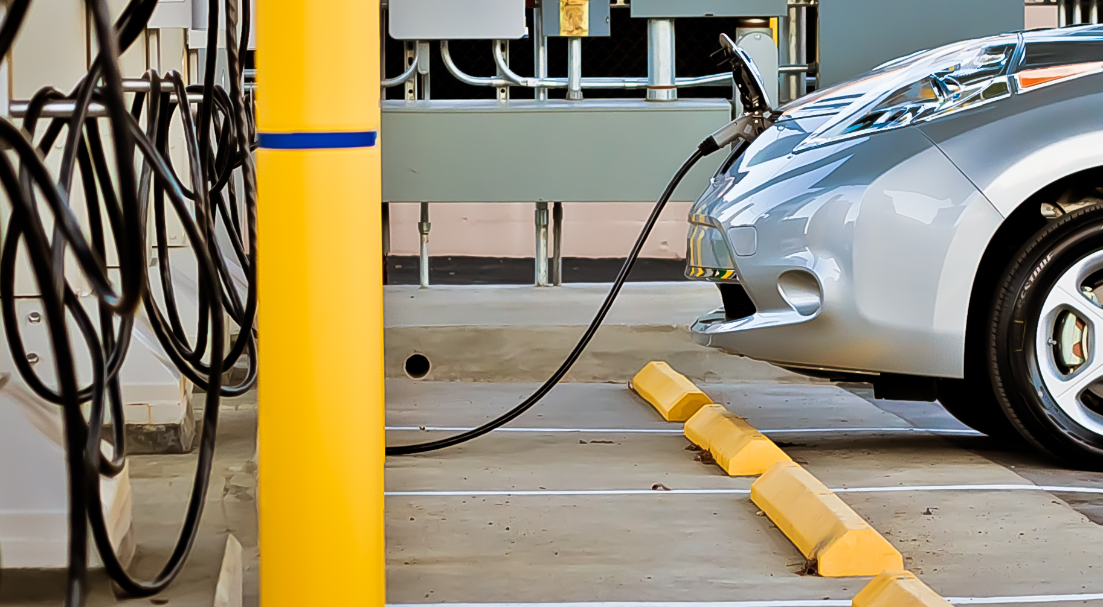
Low Carbon City
Photo: Derek Bruff
Since 2000, the Nordic economies have grown by 28% - at the same time the total carbon emissions have dropped by 18%.
Even though Nordic residents consume more energy per capita than the EU average, the carbon emissions are 50% lower than the average.
Copenhagen has set the ambitious target to become carbon neutral by 2025.
Notes:
Additional information on carbon emissions in the Nordic Region: This is due to the high share of renewables, good development of district heating and modern biomass systems.

Slide 32

Low Carbon City
Photo: Lydur Skulason
Oslo has installed a vast net of charging points for electric vehicles.
Gothenburg, Sweden, has an large-scale hybrid, self-driving vehicle pilot project underway.
In Iceland, geothermal power generate 25% of the country’s total electricity production.
In Finland, the so-called HINKU municipalities have reduced their emissions by 12-18% in five years by replacing fossil fuels with renewables and curbing the use of electricity.

Slide 33
Case story:
Stockholm,
Sweden
Sweden’s largest hospital is also
its greenest! Achieving the LEED Gold
standard, the hospital has a dedicated
geothermal plant that provides 65% of its heating and cooling needs.
Notes:
Read more about Ny Karolinska and its LEED Gold standard here:
http://www.nyakarolinskasolna.se/en/News-and-articles/News-at-NKS/double-environmental-certification-for-new-karolinska-solna/

Slide 34
“No nations have come so far
in proving that decoupling ecological degradation and climate change from economic growth is possible, yet still
have good living conditions in advanced societies.”
Andras Simonyi
From the book Nordic Ways
Notes:
Andras Simonyi is the Managing Director of the Center for Transatlantic Relations at the School of Advanced International Studies at Johns Hopkins University in Washington D.C. As editor of the book Nordic Ways, he really makes a case for the strengths of the Nordic countries.

Slide 35


Turning waste into a valuable resource
Notes:
Throughout the Nordic Region, city authorities, businesses and citizens are developing innovative ways to
increase the potential of products and services to create a circular economy. These are efforts that go beyond the single company or organisation.
The materials used to construct new buildings, the recycling of residents’ waste, and the energy pulled from sewage networks all contribute to greater efficiency in the existing urban systems.

Slide 36
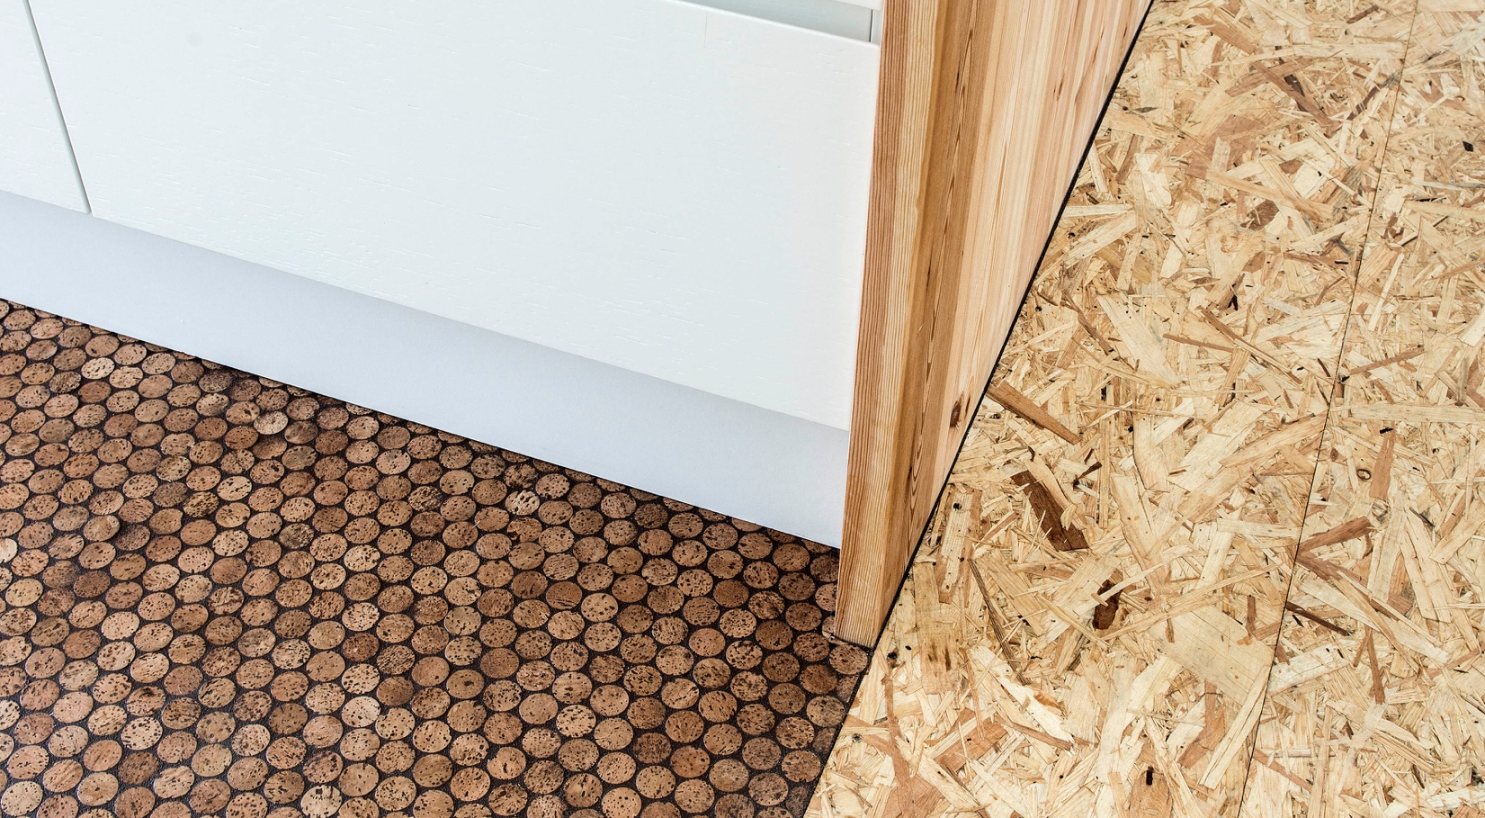
Circular Economy City
The sustainable construction company Xella Danmark produces concrete blocks that can be reused and recycled in all parts of the product life cycle.
The Finnish company Martela designs circular furniture solutions with a business model based on repairing old items and reusing and recycling materials.
Swedish retail company Houdini offers sports equipment for rent, not for sale. More than 65% of Houdini’s products have been converted into a circular life cycle.

Slide 37
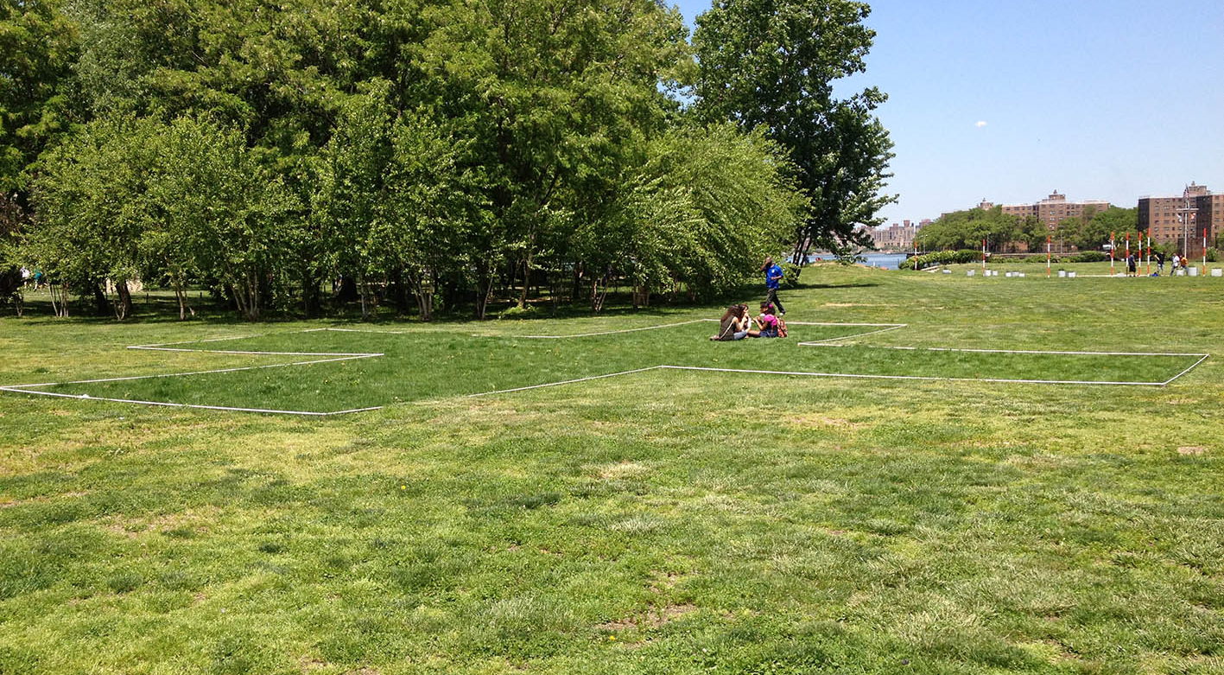
Circular Economy City
Photo: Vbenjou
In Stockholm, the Biochar Project uses park and garden waste to produce biochar (soil conditioner) and renewable energy.
Notes:
Additional information on biochar: Biochar contributes to a greener city and can decrease the levels of carbon dioxide in the atmosphere for hundreds to thousands of years. The energy is converted into heat for the city's district heating network within Open District Heating TM – a project to recycle excess heat in the City of Stockholm. The heat from the facility in Högdalen is enough to heat 80 flats a year.

Slide 38
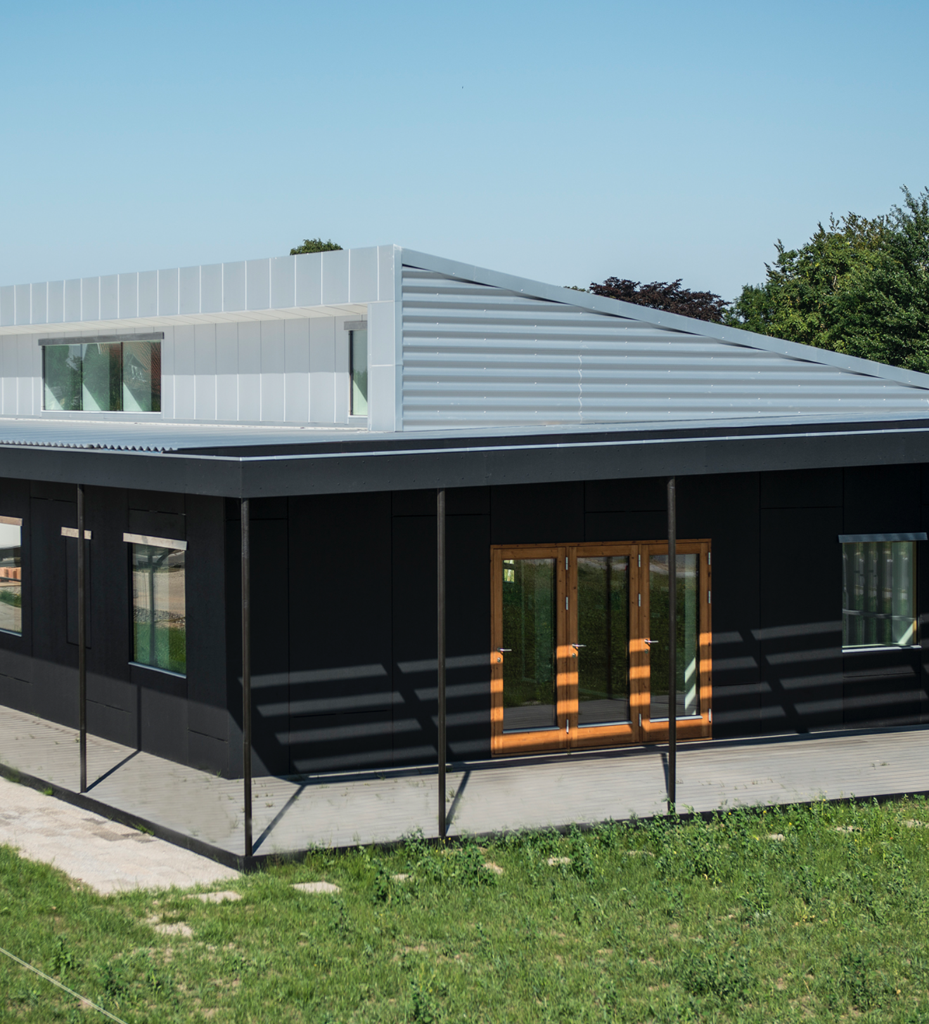
Case story:
Nyborg, Denmark
Using recycled materials at every turn, Upcycle House has reduced its material life cycle carbon emissions by 86% compared to traditional housing. Facades are made from post-consumer paper, insulation from recycled newspaper, wool and plastic, and flooring from glue-free industrial wood boards.
Notes:
Read more about Upcycle House here:
https://lendager.com/en/architecture/upcycle-house-en/
https://www.archdaily.com/458245/upcycle-house-lendager-arkitekter

Slide 39


Photo: City of Helsinki, dept of Urban development
Smart technologies create opportunities
for collaboration
Notes:
The smart city concept is revolutionising the way cities operate – and Nordic cities are at the forefront of these changes. Founded on the Nordic Region’s long history of communications technology development, city authorities, businesses and tech-savvy citizens are driving change across smart city platforms.
Technologies are, of course, of crucial importance. But so is empowering people. Digital solutions provide more information to residents and further engagement opportunities in the planning process.

Slide 40

Smart City
The Nordic countries are the most digitalised in Europe.
The Nordic countries are pioneers in smart-grid technologies.
The Nordic countries are excellent at engaging citizens through digital tools.
Notes:
Additional information on digitalised Nordic countries: Nordic cities have been early adopters of sound information and communications technology infrastructures in cities.
Additional information on smart-grid technologies: Finland is developing a system that will enable energy consumption to follow market signals and be able to maximise the benefits of renewable energy generation.
Additional information on citizen engagement: In Sweden, My Blocks, a community participation tool for the design of urban public spaces, has been used to relocate the mining city Kiruna in northern Sweden.

Slide 41

Smart City
Stockholm will be the first city in the world with a 5G network in 2018.
The Finnish company PayiQ has developed the world’s first cloud-based mobile ticketing solution for public and private urban mobility services.

Slide 42
Case story:
Helsinki, Finland
Helsinki Air Quality Testbed is the world’s first comprehensive city-wide air quality system. The vast range of sensors allow authorities and residents to access real-time air quality measurements. With data available on an open platform, the city hopes for the further development of innovative applications that can improve the quality of life in the city.
Notes:
Read more about Helsinki’s air quality testing systems here:
http://www.visithelsinki.fi/en/professional/media/newsroom/worlds-best-experts-to-build-a-unique-air-quality-iot-system-to-helsinki

Slide 43
Case story:
Reykjavik, Iceland
Smart platforms are key arenas for collaboration between cities and residents.
In Reykjavik, the ‘Your Priorities’ platform
hosts residents’ ideas on how to improve
the city. So far, over 70,000 contributions
have been submitted, resulting in 200
projects, including new road connections,
parking and children’s play areas.
Notes:
Read more about Reykjavik’s smart platforms here:
https://www.citizens.is/portfolio_page/better_reykjavik/

Slide 44
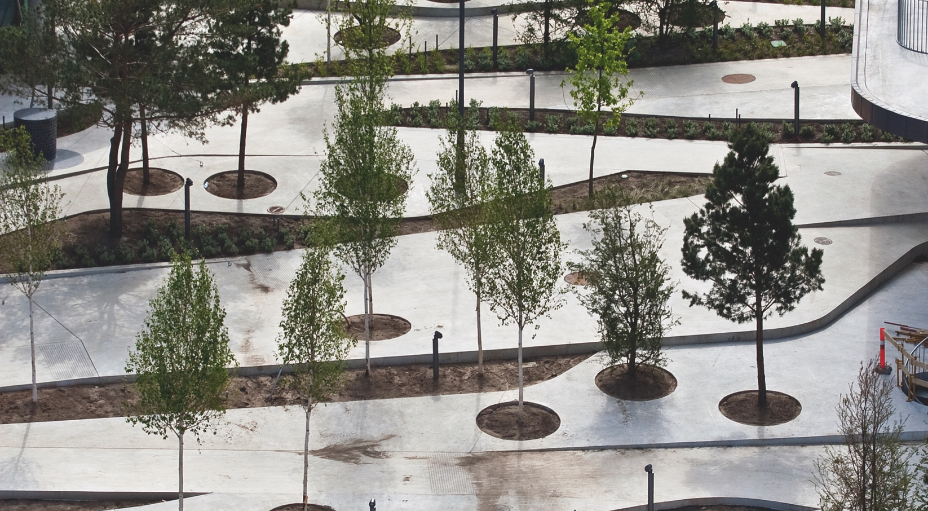

Human-centric and functional urban design
Notes:
The human experience is key element in Nordic design thinking. Nordic urban environments are based on a clear understanding of the needs and functionality associated with the everyday use of objects. As such, many Nordic urban areas are welcoming, encourage social interaction, and use public space as a meeting place for all.
From the layout of the local park to the lettering of street signs – Nordic cities acknowledge that every element of the urban environment can affect how people use and experience their city.

Slide 45

Design City
Photo: Bengt Oberger
Nordic architecture and urban design rests on a strong tradition established by designers, such as Alvar Aalto and Eero Saarinen from Finland and Jörn Utzon and Arne Jacobsen from Denmark.
Contemporary Nordic architects include Snøhetta, originating in Norway, and Bjarke Ingels Group, originating in Denmark.
Nordic countries are renowned for their high craftsmanship in product design, with an attention to detail, quality and use of local materials like wood and metal.
Furniture is Denmark’s seventh-biggest export product, with sales of USD 2.2b in 2015.
1-3. Borges, Luciane Aguiar et al. (2017): ”White Paper on Nordic Sustainable Cities”. Stockholm: Nordregio, pp. 53
4. Walker, Owen (2017): ”Making a fortune out of Scandinavian cool” in ft.com
Notes:
Additional information on Snøhetta and Bjarke Ingels Group: Snøhetta’s international projects include the redesign of the New York’s Time’s Square and a new building for San Francisco Museum of Modern Art. Bjarke Ingels Group’s international projects include a skyscraper and a grand climate adaptation plan in Manhattan.
Additional information on product design: Famous examples are Iittala and Marimekko from Finland, Poul Henningsen and Finn Juhl from Denmark

Slide 46
Case story:
Copenhagen, Denmark
Taking inspiration from the Swedish
landscape, the space between SEB
Banks’ two buildings in Copenhagen has
been transformed into a multifunctional
urban space. Rising from street level,
the park area uses trees, grasses, ferns
and mosses to create a ‘Nordic’ feel while encouraging recreation, even providing skateboard-friendly slopes and ledges.
Notes:
Read more about SEB Bank’s buildings in Copenhagen here:
http://www.ltarkitekter.dk/seb/

