Slide 1
Roadmap development Introduction

Slide 2
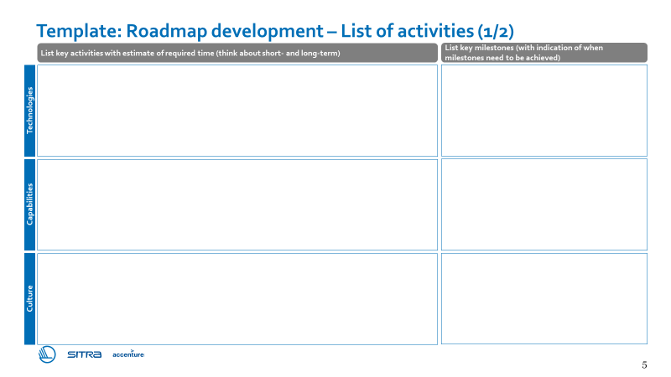

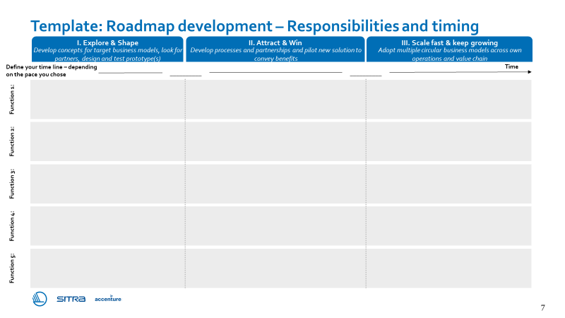
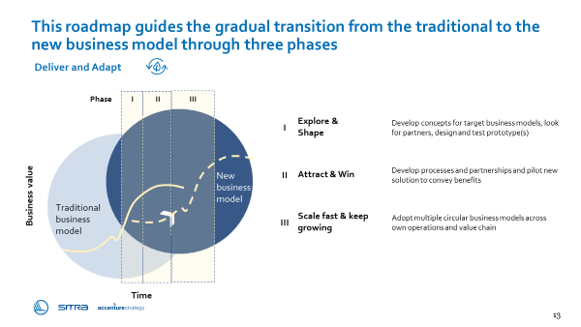
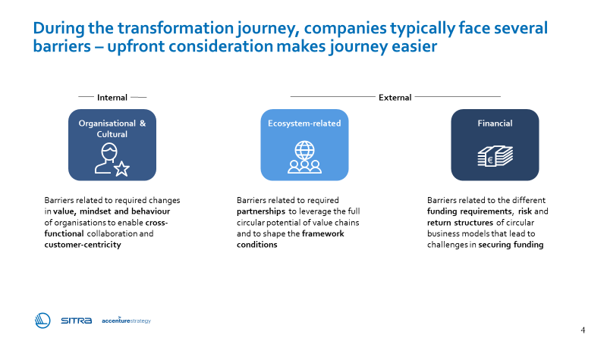
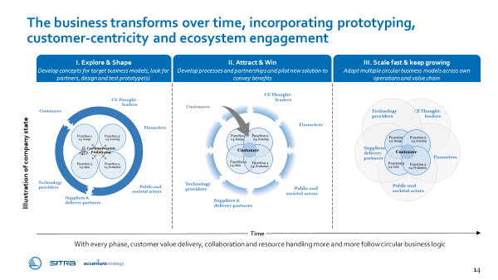
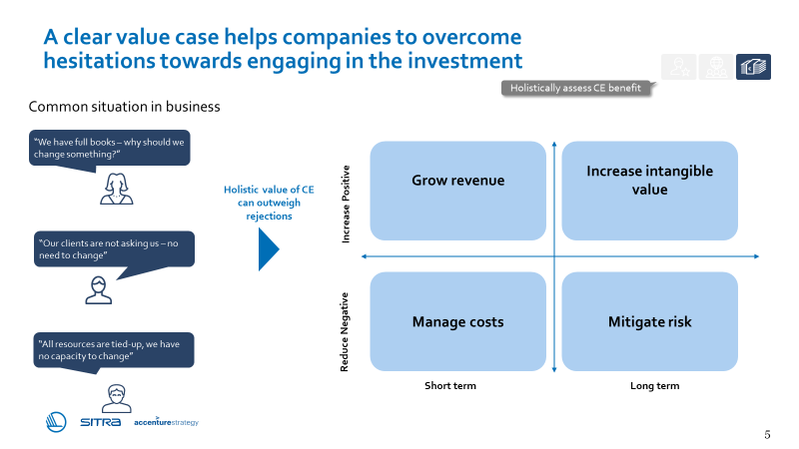
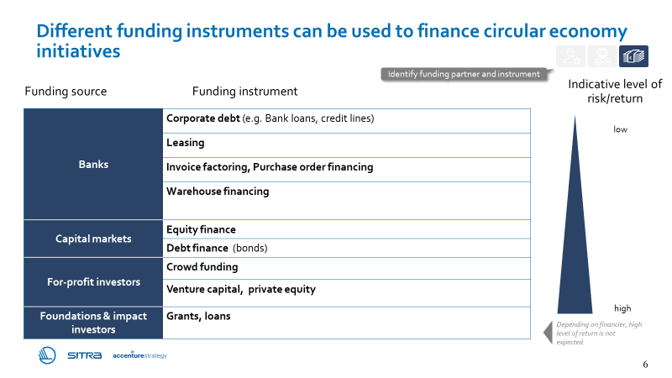
Roadmap development – introduction
Purpose
The purpose of the roadmap development tool is to support you in planning the first steps on your circular transformation journey on a high-level, through listing key activities, estimating the time to complete them and prioritizing them into short, medium and long-term.
Illustration of the tool
Instructions
Summarize key activities required in terms of technologies, capabilities, culture, ecosystem and finance based on your earlier assessments to the ‘List of activities’ sheet
Write key functions contributing to the implementation of your circular idea to the ‘Responsibilities and timing’ sheet
Define a timeline for your transformation journey
Define responsible functions (and if possible, name people to approach) and appropriate phase for each activity
Tip: Use sticky notes to list the activities – it saves time and allows flexibility!
Supporting materials
Chapter 5:
How to design the transformation journey?
Three phases of the transformation journey
Key barriers and ways to overcome them
Illustrative playbook pages – please refer to the entire chapter for support.

Slide 3
Roadmap development – example
Example
Illustrative example for Build to last business model with consecutive development of Repair & Maintain

Slide 4
Roadmap development Tool

Slide 5
Template: Roadmap development – List of activities (1/2)
List key activities with estimate of required time (think about short- and long-term)
List key milestones (with indication of when milestones need to be achieved)
Technologies
Capabilities
Culture

Slide 6
Template: Roadmap development – List of activities (2/2)
List key activities with estimate of required time (think about short- and long-term)
List key milestones (with indication of when milestones need to be achieved)
Ecosystem
Finance

Slide 7
Template: Roadmap development – Responsibilities and timing
Define your time line – depending on the pace you chose
I. Explore & Shape
II. Attract & Win
III. Scale fast & keep growing
Develop concepts for target business models, look for partners, design and test prototype(s)
Develop processes and partnerships and pilot new solution to convey benefits
Adopt multiple circular business models across own operations and value chain
Time
__________
__________
Function 1:
Function 2:
Function 3:
Function 4:
Function 5:

