Slide 1
Ecosystem partner identification
Introduction

Slide 2
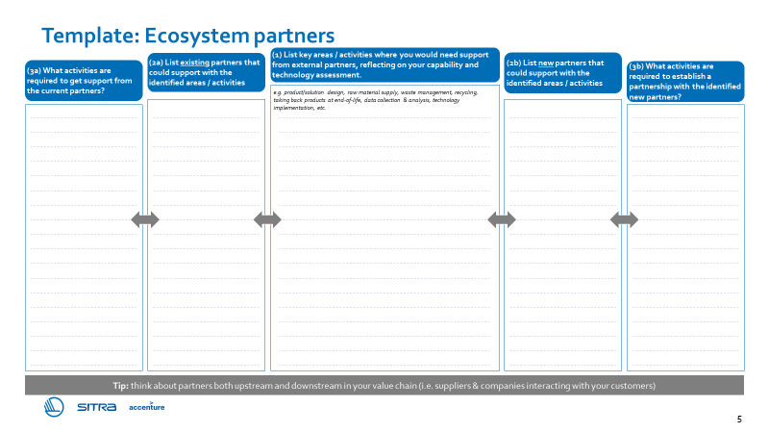
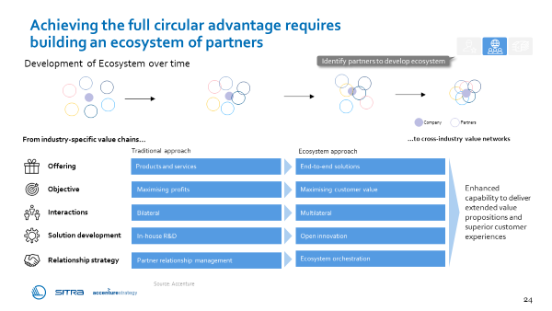
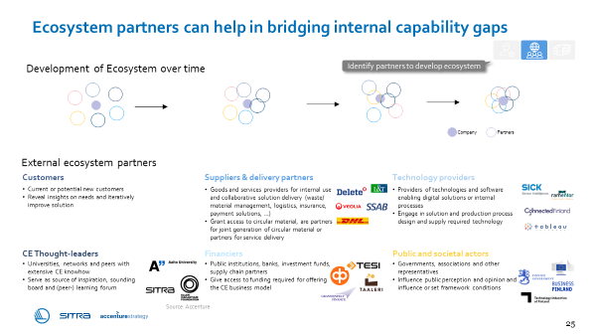
Ecosystem partner identification – introduction
Purpose
The ecosystem partner identification tool supports you in identifying external partners that can help in bridging internal capability and technology gaps
listing activities required to get the needed support / establish the partnerships
Illustration of the tool
Instructions
1) List key areas / activities where you would need support from external partners, reflecting on your capability and technology assessment
2a) List existing partners that could support with the identified areas / activities
2b) List potential new partners that could support with the identified areas / activities, where existing partners are not able to help
3a) Write down actions required to get required support from existing partners
3b) Write down actions required to establish required new partnerships
Supporting materials
Chapter 5: How to design the transformation journey?
Ecosystem development
Potential ecosystem partners
Illustrative playbook pages – please refer to the entire chapter for support.

Slide 3
Ecosystem partner identification – example
Example
Example activity:
Request an offer from Company ABC
Example partner:
Company ABC
Example activity:
Product take-back at end-of life
Example activity:
3D printing technology
Example partner:
3D tech Company DEF
Example activity:
Book a meeting & request prototype for testing

Slide 4
Ecosystem partner identification
Tool

Slide 5
Template: Ecosystem partners
(2a) List existing partners that could support with the identified areas / activities
(1) List key areas / activities where you would need support from external partners, reflecting on your capability and technology assessment.
(2b) List new partners that could support with the identified areas / activities
(3a) What activities are required to get support from the current partners?
(3b) What activities are required to establish a partnership with the identified new partners?
e.g. product/solution design, raw material supply, waste management, recycling, taking back products at end-of-life, data collection & analysis, technology implementation, etc.
Tip: think about partners both upstream and downstream in your value chain (i.e. suppliers & companies interacting with your customers)

