Slide 1

partner toolbox
Notes:
Blå

Slide 2
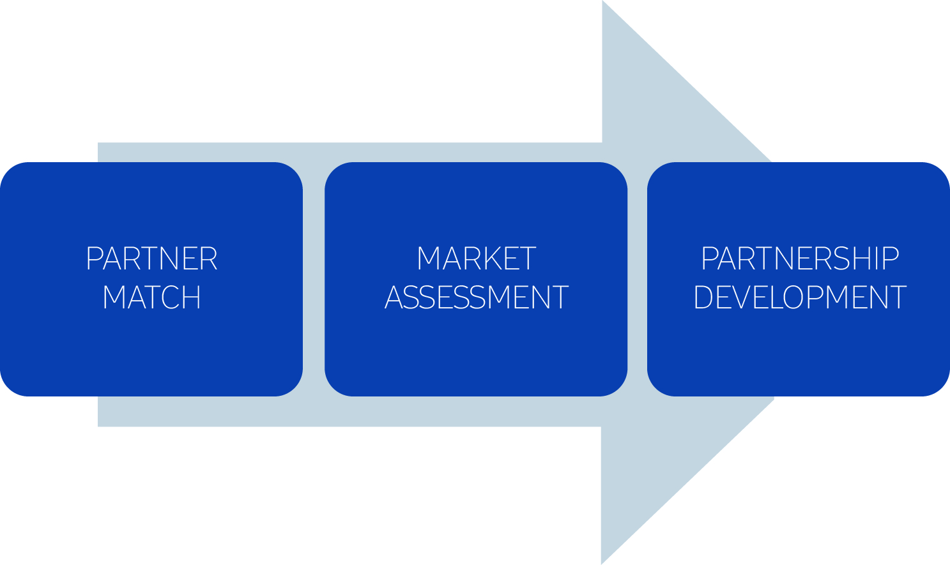
THE PROCESS: STEP 1 - 3
Partner Match | Joint Market Assessment | Partner Management
Partner Roles Partner Profile Partner Evaluation & Selection | Product Map Customer Segmentation Channels Stakeholder Map Key Purchasing Factors Import & Price Point Competitor Mapping Market Position Go-to-market Plan | Business Plan Partner Monitoring & Assessment

Slide 3
❶
PARTNER MATCH

Slide 4
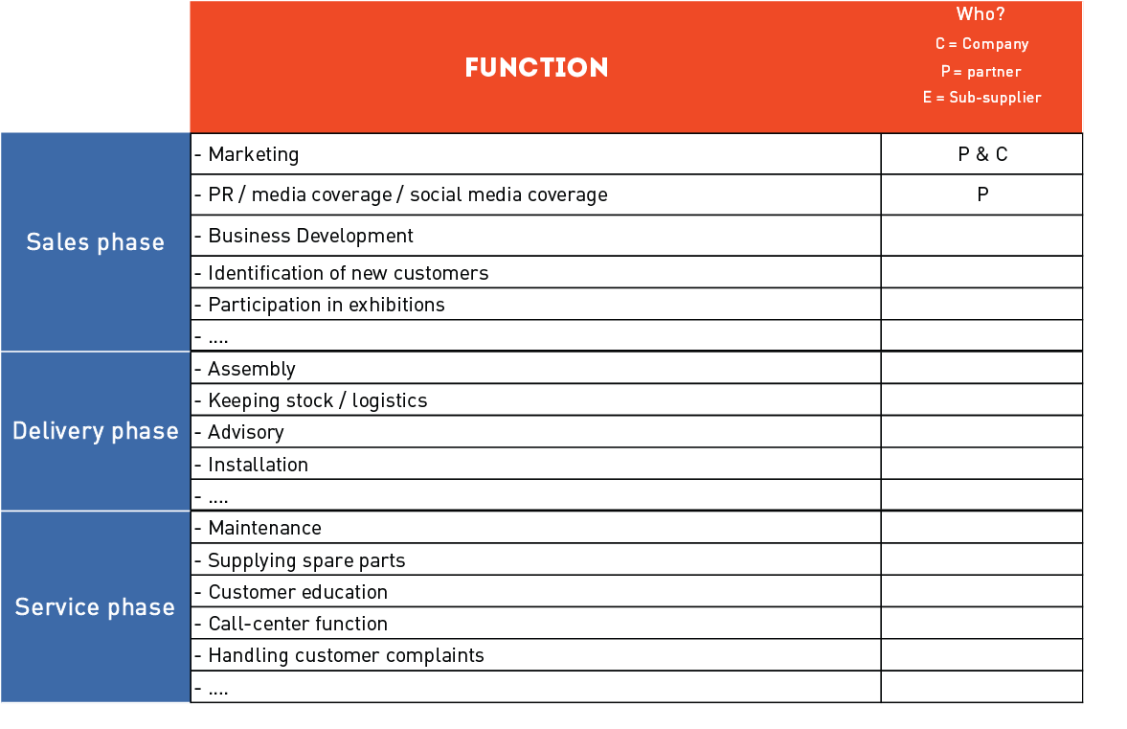

PARTNER ROLES

Slide 5
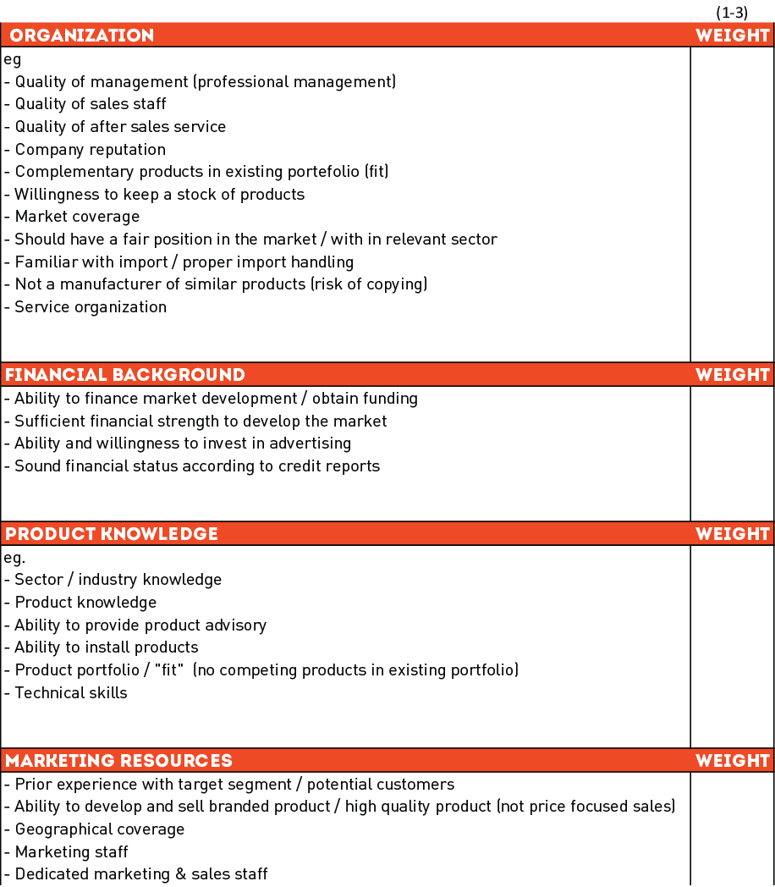
PARTNER PROFILE

Slide 6

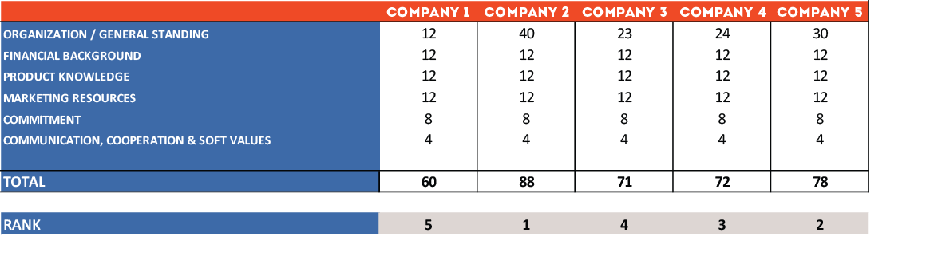
PARTNER EVALUATION & SELECTION
Partner Evaluation

Slide 7
❷
JOINT MARKET ASSESSMENT

Slide 8
PRODUCT
Which product
?

Slide 9
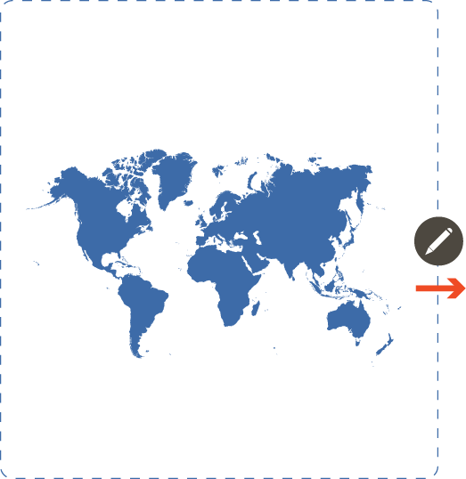

MAP
Select the target market

Slide 10

Customer SEGMENTATION
Customer Characteristics
A
Product
B
C

Slide 11
CHANNELS
Sales Channel & DECISION MAKERS
A
Manufacturer
B
Manufacturer
C
Manufacturer

Slide 12
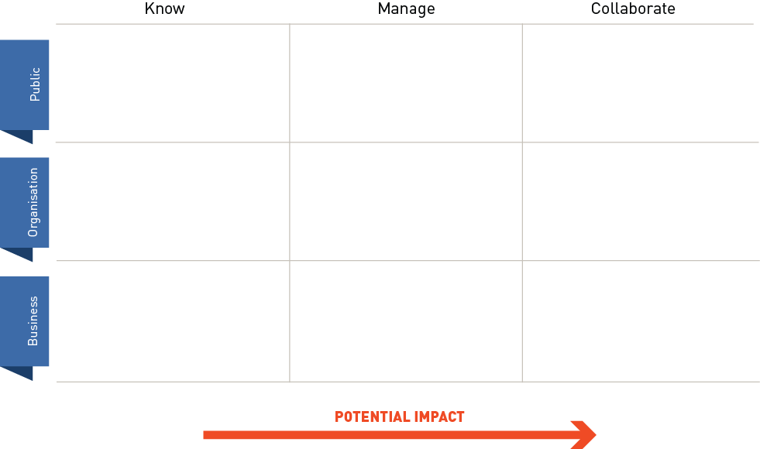
STAKEHOLDER MAP

Slide 13
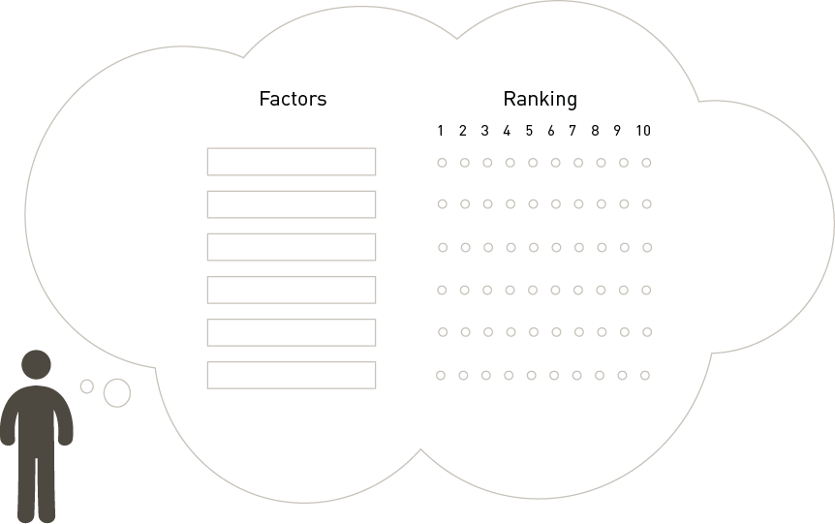
KEY PURCHASING FACTORS
Segment: ____________________

Slide 14

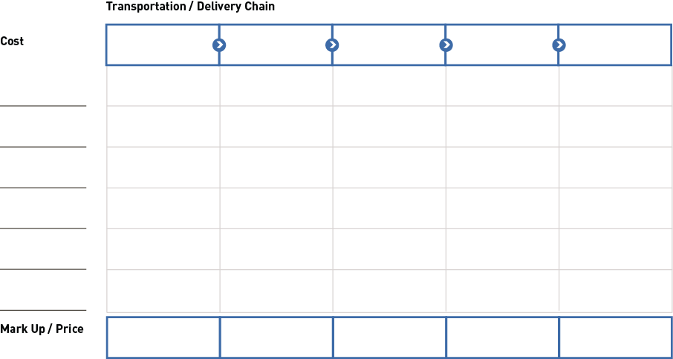
IMPORT & PRICE POINT
Notes:
Ændringer:
-I stedet for “TRANSPORTATION / DELIVERY CHAIN” skal der stå “DISTRIBUTION STEPS”
-Vi ville gerne have at cost rykkes ned midt for til venstre I en blå fane magen til de tidl. Benyttede.
Under cost skal der udarbejdes en standardiseret liste som dækker over de “oftest” forekommende omkostninger.
Udover disse skal der være et antal XX bokse til sel at tilføje andre omkostning i.

Slide 15
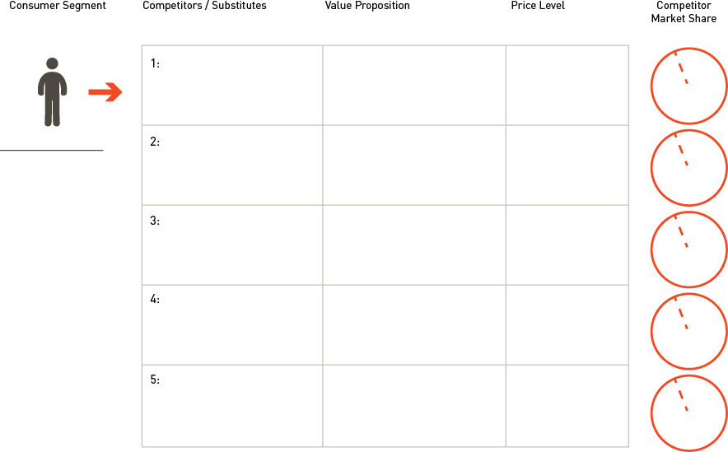
COMPETITOR MAPPING
Notes:
-Consumer Segment, Value Proposition og competitor Market share. I alle disse er det kun det første og som skal starte med stort bogstav.
-Stavefejl: Substitudes staves, Substitutes(med t)
-Linjerne til navne efter de storte mænd skal fjernes og boksene gøres I stedet større.(altså rykke det hele mod venstre.

Slide 16
MARKET POSITION
Unique Selling Points
A
Product
B
C

Slide 17
GO-TO-MARKET PLAN
What are you selling?
(Value Proposition / Key Purchasing Factors)
Who are you selling to? (Segments)
Go-To-Market
What
Who
How
Where
How will you reach your target market? (Channels)
Where will you promote your product?
(Marketing Strategy)
Notes:
Value Proposition: / key purchasing factors What are you selling?
Segments: Who are you selling to?
Sales Channels: How do you reach your target customer?
Marketing Strategy / Plan: Where are you promoting your product?
Pricing Strategy for local market
Partnership Strategy – how to develop the good cooperation?
1 years business plan for distributor cooperation
Defining goals / setting KPI / measurable

Slide 18
❸
PARTNERSHIP DEVELOPMENT

Slide 19
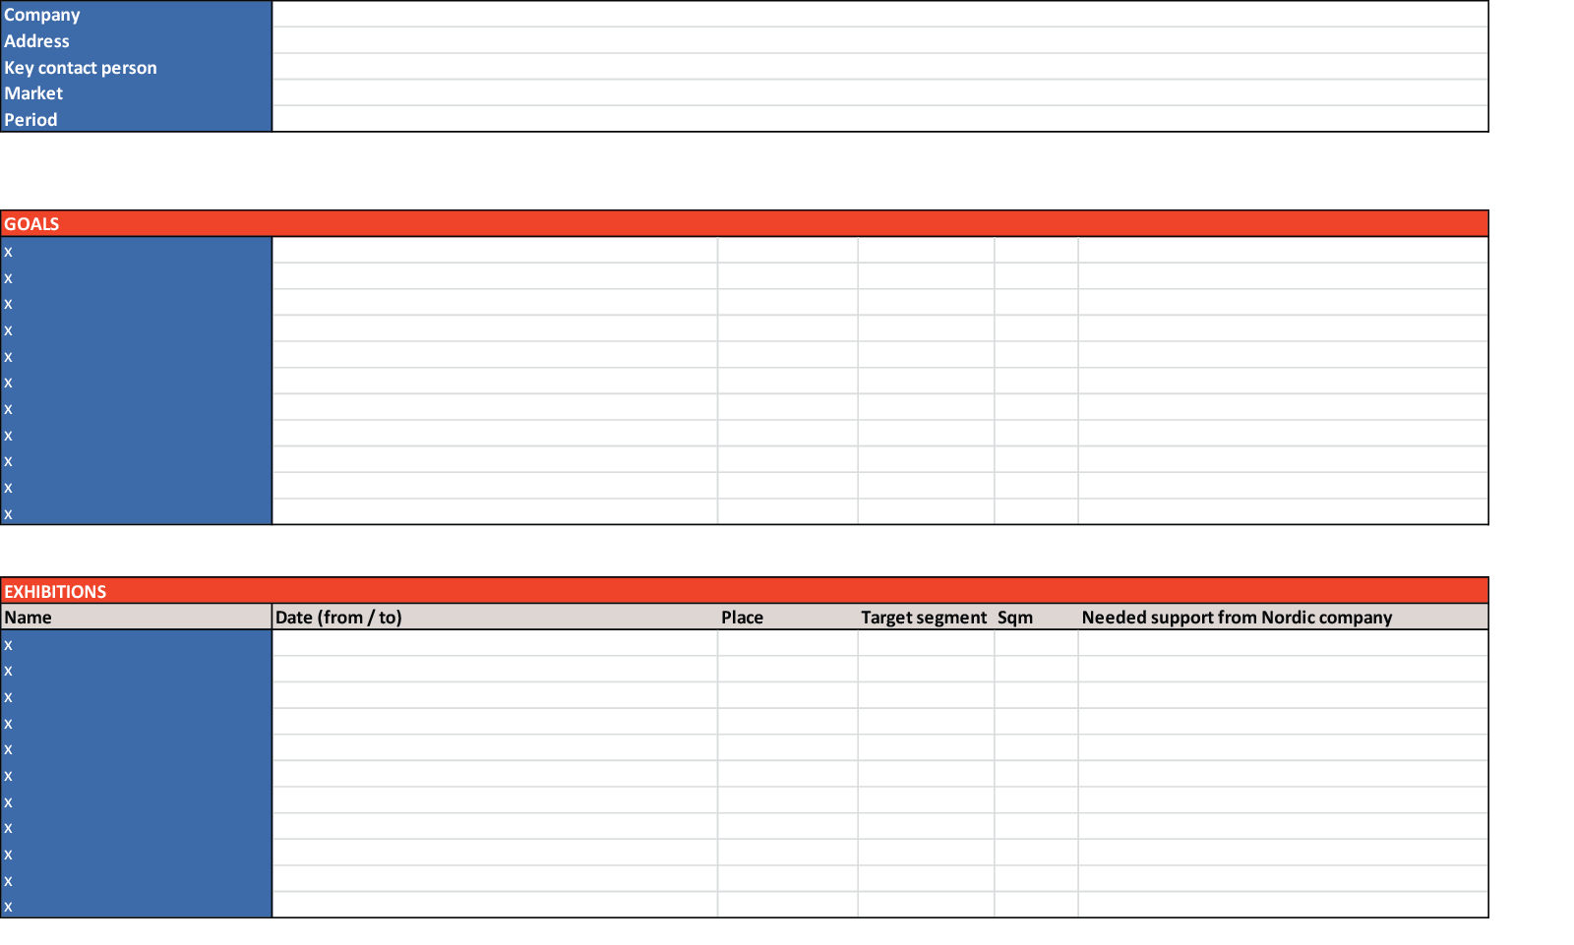
BUSINESS PLAN

Slide 20
PARTNER MONITORING & ASSESSMENT
High
Consider forward integration
Grow partner
Switch entry mode into own subsidiary
Maintain position
Grow partner
Market Attractiveness
Medium
Get new partner
Maintain position
Maintain position
Consider 'low cost' mode
Exit
Low
High
Medium
Low
Partner Performance

Slide 21
PARTNER MONITORING & ASSESSMENT
2nd year assessment
Monitoring:
High
Consider forward integration
2nd year
assessment
Grow partner
Switch entry mode into own subsidiary
Maintain position
Grow partner
Market Attractiveness
Medium
Get new partner
Maintain position
1st year
assessment
Maintain position
Consider 'low cost' mode
Exit
Low
High
Medium
Low
Partner Performance

